Slide 1
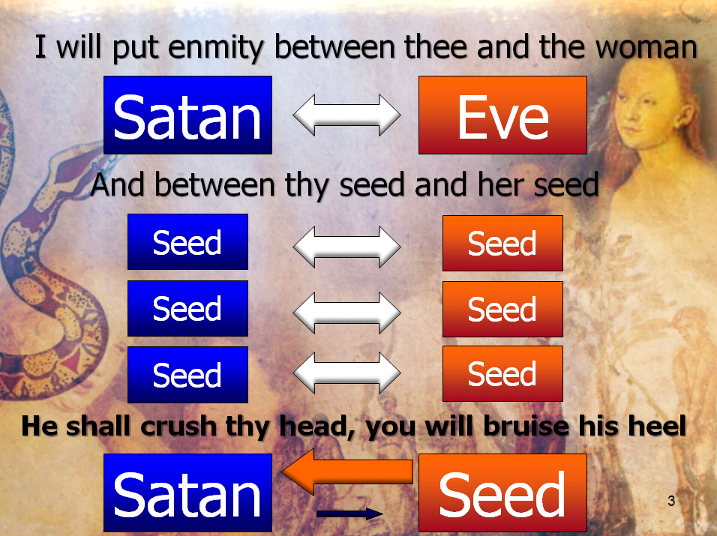
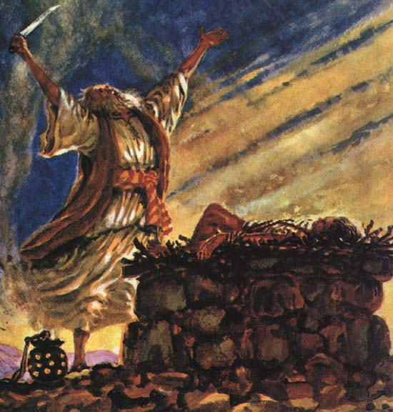
Gen 12—22
God finally gets on the offensive
Gen 3: Fall curse
Gen 6: More sin flood
Gen 11: Babel languages
Notes:
Fall—curse
Universal wickedness—flood
Babel—languages

Slide 2
5A God’s Word of Judgment comes upon the families which settle . . . 10:1--11:9
Which was more devastating: Flood or Babel?
The languages force a dispersal into divided nations.
They are necessary to prevent further world-wide unity against God,
but regrettable because they are so foreign to the vision of a single, life-celebrating community.
Notes:
In terms of the progress of God’s over-all plan of building a life-celebrating community

Slide 3
Creation
Restoration
Cain
Creator
Lamech
Redemption
Fall
“Daughters of men”
Flood
Babel
Abraham
Notes:
Things are really going downhill and God’s program, though technically advancing through the chosen line, is basically in a defensive posture… we’re reacting but not really on the offensive.
Babel is now the low point in God’s program with the regrettable, but necessary, dispersal into nations. However, in the very next chapter God goes on the offensive so to speak and begins to meet the failure of chapter 11 with the promises of 12.

Slide 4
1A God’s Promise to Abraham...
1B God Separates Abram from his natural...
Genesis 12:1-3
1 The LORD had said to Abram, “Leave your country, your people and your father’s household and go to the land I will show you.
2 “I will make you into a great nation
and I will bless you;
I will make your name great,
and you will be a blessing.
3 I will bless those who bless you,
and whoever curses you I will curse;
and all nations on earth
will be blessed through you.”

Slide 5
Land
12:1
Nation
12:2
Leader
12:3

Slide 6
2
Concepts

Slide 7
12:3 “All nations on earth will be
blessed THROUGH you”
Blessing
God
Abram
Nations

Slide 8
12:3 “All nations on earth will be
blessed THROUGH you”
In Galatians 3:8 Paul refers to Gen 12:3 like this:
“The Scripture ... announced the Gospel in advance to Abraham: ‘All nations will be blessed through you’”

Slide 9
12:3 “All nations on earth will be
blessed THROUGH you”
God
(you, Abe, are merely the channel for the Seed: He is where the blessing really comes from)
Relationships
Rule
Abram
Nations
Seed

Slide 10
Land
Nation
Leader
3:15, SEED

Slide 11
Nation
Exodus 19:6, “I will make you into a “kingdom of priests.”
God
Priest
of Priests
Other Nations,
i.e. the whole world!
to tell them about . . .
Nation
3:15, SEED

Slide 12
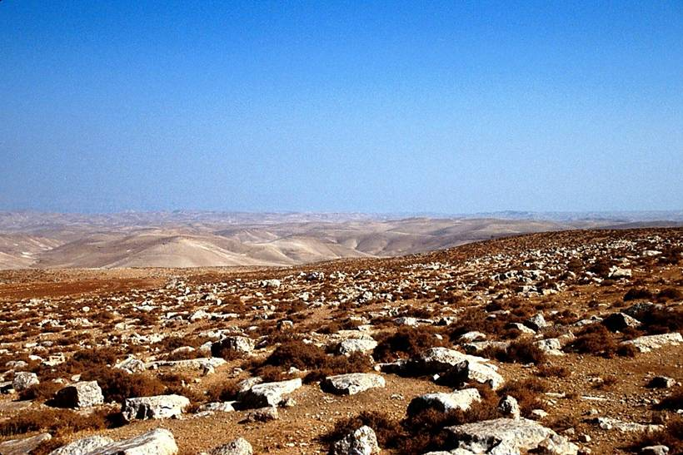
Land
Garden of Eden?

Slide 13
Europe
Land
Asia
Africa

Slide 14
Gen 12:1-3 is not distinct from Gen 3; in fact it is directly based upon, and expands, the original promise.
Land
Nation
Leader
3:15, SEED

Slide 15
2nd
Concept

Slide 16
Gen 12:1
Note the wording carefully
1 The LORD had said to Abram,
“Leave your country, your people and your father’s household and go to the land I will show you.
Command
Condition
The promises of God in Gen 12:1-3 will be fulfilled because He said so . . . whether anyone believes them or not. They are
Un
Straight declaration
al
If . . . Then

Slide 17
1A God’s Promise to Abraham...
1B God Separates Abram from his natural...
God supernaturally
intervenes . . .
Abram
Sarai
Land
Unconditional
Nation
He Spoke
the promises.
Leader
Pharaoh

Slide 18
1A God’s Promise to Abraham...
1B God Separates Abram from his natural...
2B God Confirms His commitment to Bless...
1C God restates and expands the promise
15:1 After these things the word of the Lord came to Abram in a vision: “Fear not, Abram! I am your shield and the one who will reward you in great abundance.”
15:2 But Abram said, “O Sovereign Lord, what will you give me since I continue to be childless, and my heir is Eliezer of Damascus?” 15:3 Abram added, “Since you have not given me a descendant, then look, one born in my house will be my heir!”
15:4 But look, the word of the Lord came to him: “This man will not be your heir, but instead a son who comes from your own body will be your heir.” 15:5 He took him outside and said, “Gaze into the sky and count the stars—if you are able to count them!” Then he said to him, “So will your descendants be.”
15:6 Abram believed the Lord, and the Lord credited it to him for righteousness.
Land
Nation
Leader

Slide 19
1A God’s Promise to Abraham...
1B God Separates Abram from his natural...
2B God Confirms His commitment to Bless...
1C God restates and expands the promise
15:7 The Lord said to him, “I am the Lord who brought you out from Ur of the Chaldeans to give you this land to possess.” 15:8 But Abram said, “O Sovereign Lord, by what can I know that I am to possess it?”
15:9 The Lord said to him, “Take for me a heifer, a goat, and a ram, each three years old, along with a dove and a young pigeon.”
Bernie
BLOOD
Bernie vows to keep his conditions
& Julio vows to keep his conditions
BLOOD
Julio

Slide 20
1A God’s Promise to Abraham...
1B God Separates Abram from his natural...
2B God Confirms His commitment to Bless...
1C God restates and expands the promise
15:7 The Lord said to him, “I am the Lord who brought you out from Ur of the Chaldeans to give you this land to possess.” 15:8 But Abram said, “O Sovereign Lord, by what can I know that I am to possess it?”
15:9 The Lord said to him, “Take for me a heifer, a goat, and a ram, each three years old, along with a dove and a young pigeon.”
W
Abram
BLOOD
Abram vows to keep his conditions
& God vows to keep his conditions
BLOOD
God

Slide 21
1A God’s Promise to Abraham...
1B God Separates Abram from his natural...
2B God Confirms His commitment to Bless...
1C God restates and expands the promise
Zzz
Abram
BLOOD
There are NO “human” conditions
& God vows to keep his conditions
BLOOD
God

Slide 22
1A God’s Promise to Abraham...
1B God Separates Abram from his natural...
2B God Confirms His commitment to Bless...
1C God restates and expands the promise
15
12
3:15

Slide 23
1C God restates and expands the promise, 15:1-21
2C God’s promise to Abraham conflicts... 16:1-15
3C God commands a sign of the promise, 17:1-27
Abraham’s response to his name change,
“Father of many nations”?
Laughter
= Isaac
(English)
(Hebrew)

Slide 24
1C God restates and expands the promise, 15:1-21
2C God’s promise to Abraham conflicts... 16:1-15
3C God commands a sign of the promise, 17:1-27
4C God separates a seed from the world, 18:1-19:29
Land
Culture
Impatience
“Reinterpretation”
Circumstances
Physical limitations
VS
Nation
Leader

Slide 25
Well that’s great news, but how do you know?
Wait a minute, who are you, and how can you be born?
Yes, you will have a son.
If Isaac isn’t born then I can’t be born
Sorry, it gets complicated. Just stay away from kings who think your wife is hot, OK? Trust me…

Slide 26
Well that’s so silly to think a woman my age could be a mother?! Isaac, isaac, isaac!!

Slide 27
5C God’s preservation of Sara for the sake, 20:1-18
Still...
God supernaturally
intervenes . . .
Abram
Sarai
Land
Unconditional
Nation
He Spoke
the promises.
Leader
Abimelech

Slide 28
5C God’s preservation of Sara for the sake, 20:1-18
6C The promises of God...partially fulfilled, 21

Slide 29
7C God confirms Abraham’s faith in the promises, 22
Traditionally:
1) Do you love your boy more than God?
2) Just how “obedient” will you be?
In Reality:
Do you believe that I will keep my promises?

Slide 30
Hebrews 11:17-19
By faith Abraham, when God tested him, offered Isaac as a sacrifice.
He who had received the promises was about to sacrifice his one and only son, even though God had said to him, “It is through Isaac that your offspring will be reckoned.”
Abraham reasoned that God could raise the dead, and figuratively speaking, he did receive Isaac back from death.
Abraham
Isaac
Land
Nation
Leader

Slide 31
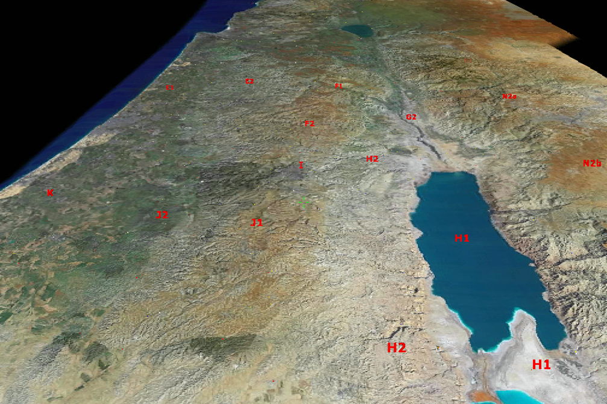
Jerusalem
Moriah
Beersheba

Slide 32
He shall crush thy head, you will bruise his heel
Noah
Satan
Seed
Isaac
Hebrews 11:17 By faith Abraham, when he was tested, offered up Isaac, and he who had received the promises was offering up is only begotten son. (NASB).

Slide 33
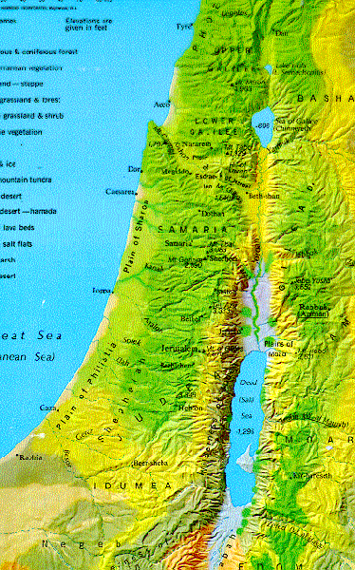
3B The Transition of the Promises to Isaac
Death of Sarah & 400 shekels!

Slide 35
What does this say about the fulfillment of the promises?
L
Land
Nation
Leader

Slide 36
Hebrews 11:13-14
All these people were still living by faith when they died.
They did not receive the things promised; they only saw them and welcomed them from a distance.
And they admitted that they were aliens and strangers on earth.

Slide 37
Hebrews 11:39-40
39 These were all commended for their faith, yet none of them received what had been promised. 40 God had planned something better for us so that only together with us would they receive the promises.

Slide 38
Creation
Restoration
Cain
Creator
Lamech
Redemption
Fall
“Daughters of men”
Flood
Babel
Abraham
Notes:
Things are really going downhill and God’s program, though technically advancing through the chosen line, is basically in a defensive posture… we’re reacting but not really on the offensive.
That all starts to change today with Abraham.
Some have misinterpreted and thought that God’s choice of an individual (Abraham) was an abandonment of the world, but nothing is further from the truth. Abraham, (the individual) is the channel to bless the world. God isn’t giving up on the world, he is even more aggressively going after it through Abraham.

Slide 39
12
Overview of Gen 12-25
Land
3:15
O n e T h e m e
Nation
15 tries the “adopt a seed” program
17-18 laughs at the promise
20 Abandons wife… again
Leader
16 sleeps with the maid
22 sacrifices the seed
12
Abandons wife

Slide 40
So, what was Abraham in Gen 22?
“Was not our ancestor Abraham considered righteous for what he did when he offered his son Isaac on the altar? . . .
And the Scripture was fulfilled that says, ‘Abraham believed God, and it was credited to him as righteousness,’ and
he was called God’s friend.”
James 2:21-23
Notes:
This is not dumbing down theology, this is straight theology. Heaven is a place where God hangs out with his friends . . . Willard on who we become.
God is not interested in you becoming famous… he just wants you to be intimately connected with the only One who really is.

