Slide 1
Amos
Farmer Bob goes
to the Big City!

Slide 2
The Historical Situation: Location
Jeroboam:
Israel
Rehoboam:
Judah

Slide 3
Historical Background: What Bethel was like…
1 Kings 12:26-27 Jeroboam thought to himself, "The kingdom will now likely revert to the house of David.
27 If these people go up to offer sacrifices at the temple of the LORD in Jerusalem, they will again give their allegiance to their lord, Rehoboam...

Slide 4
Historical Background: What Bethel was like…
1 Kings 12:28 After seeking advice, the king made two golden calves. He said to the people, "It is too much for you to go up to Jerusalem. Here are your gods, O Israel, who brought you up out of Egypt."
Deuteronomy 13
Wrong gods

Slide 5
Historical Background: What Bethel was like…
1 Kings 12:29 One he set up in Bethel, and the other in Dan. 30 And this thing became a sin; the people went even as far as Dan to worship the one there.
Deuteronomy 12
Wrong place!

Slide 6
Historical Background: What Bethel was like…
1 Kings 12:31 Jeroboam built shrines on high places and appointed priests from all sorts of people, even though they were not Levites.
Deuteronomy 18
Wrong Personnel

Slide 7
Historical Background: What Bethel was like…
1 Kings 12:32 He instituted a festival on the fifteenth day of the eighth month, like the festival held in Judah, and offered sacrifices on the altar. This he did in Bethel, sacrificing to the calves he had made. And at Bethel he also installed priests at the high places he had made.
Deuteronomy 16
Wrong Times

Slide 8
2A Oracles Against the Nations: Introduction of Theme, 1:3--2:16
1B Introduction & Background, 1:3--2:5
1C Judgment for Damascus
Amos 1:3-5
3 This is what the LORD says:
“For three sins of Damascus,
even for four, I will not turn back my wrath.
Because she threshed Gilead
with sledges having iron teeth,
4 I will send fire upon the house of Hazael
that will consume the fortresses of Ben-Hadad.
5 I will break down the gate of Damascus;
The people of Aram will go into exile to Kir,”
says the LORD.

Slide 9
2A Oracles Against the Nations: Introduction of Theme, 1:3--2:16
1B Introduction & Background, 1:3--2:5
1C Judgment for Damascus
2C Judgment for Philistia
3C Judgment for Tyre
4C Judgment for Edom
5C Judgment for Ammon
6C Judgment for Moab
7C Judgment for Judah
2B The Message: Judgment for Israel, 2:6-16

Slide 10
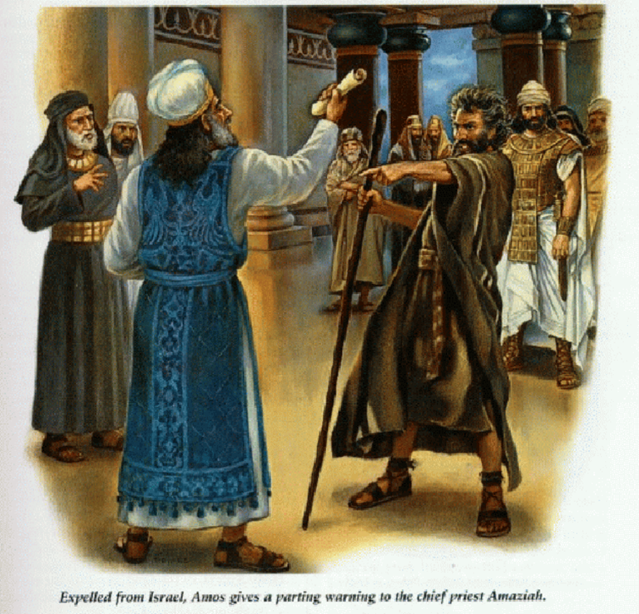
Farmer Amos treated badly by the establishment at Bethel

Slide 11
The middle part of the book
3A Proclamations Against Israel: The Reasons for Judgment, 3:1--6:14
1B Hear this Word, People of Israel, 3:1-12
2B Hear this Word,
3B Hear this Word,
4B Woe to Israel
5B Woe to Israel

Slide 12
The middle part of the book (a sample sermon)
3A Proclamations Against Israel: The Reasons for Judgment, 3:1--6:14
1B Hear this Word, People of Israel, 3:1-12
Amos 3:1-2 Hear this word the LORD has spoken against you, O people of Israel -- against the whole family I brought up out of Egypt:
2 "You only have I chosen of all the families of the earth;
therefore I will punish you for all your sins."
Cool, so we get away with more stuff, right? Since WE are your favorite children, you’ll just overlook our sin!!!

Slide 13
The last part of the book: Picturing Judgment
4A The Visualization of Judgment: Picturing the theme, 7:1--9:15
3B Judgment & Blessing Determined, 9:1-15
Amos 9:11-12 “In that day I will restore David’s fallen tent. I will repair its broken places, restore its ruins, and build it as it used to be,

Slide 14
When David came to rule in Jerusalem and enjoyed his palace he looked at God’s house (a mobile home). “I’ll build you a permanent house, God!”
2 Samuel 7:11-12 ‘The LORD declares to you that the LORD himself will establish a house for you:
12 When your days are over and you rest with your fathers, I will raise up your offspring to succeed you, who will come from your own body, and I will establish his kingdom.
House = dynasty, i.e., a succession of a son and a grandson and a great grandson on the throne.

Slide 15
Amos 9:11-12 “In that day I will restore David’s fallen tent. I will repair its broken places, restore its ruins, and build it as it used to be,
Major
Messianic
Promise
THE Son of David reigns
David’s sons reign
NO sons reign
1000 BC
586 BC
??? AD
Notes:
Compare to Matthew 1:1 and the Davidic, national, political promise comes first as he comes to redeem Israel first and then through them, the nations.

Slide 16
Amos 9:13-15 “The days are coming,” declares the LORD, "when the reaper will be overtaken by the plowman and the planter by the one treading grapes. New wine will drip from the mountains and flow from all the hills.
14 I will bring back my exiled people Israel; they will rebuild the ruined cities and live in them. They will plant vineyards and drink their wine; they will make gardens and eat their fruit.
15 I will plant Israel in their own land, never again to be uprooted from the land I have given them," says the LORD your God.
October
December
April
Good
Harvest
When the plowers work
Messianic Harvest
Notes:
So much of our work is just to keep our heads above water… financially and this puts an end to all that….
The kingdom is about doing what we’re created to do, what we will then want to do, invest in relationships & endless creative endeavors.

Slide 17
The Historical Situation
Suppose through some providential design, the National Organization of Women mistook you for a famous advocate of “Women’s rights” (as they understood the term) and asked you to address their national convention on the topic of “Women’s rights and pregnancy.”

Slide 18
The Historical Situation
What kind of strategy would
you use for your speech?
What kind of introduction
would you use?

