Slide 1
Joel, Habakkuk, Obadiah
Prophets of Despair ?

Slide 2
Review of M, N, Z
Why the world secretly dreams about the leadership that only Jesus can give.
Even the statue in front of the UN building represents a longing for conditions that only Messiah can bring.
What it means to really trust God when other people treat you badly.
When I want good for those who hurt me I’m overcoming evil with Good.
Why also is such a wicked word.
Syncretism is the error of mixing truth and error, of “worshiping Yahweh and Molech”

Slide 3
Preview for J, H, O
Joel: Another example of how God is the relentless pursuer
Habakkuk: Listening in on a private conversation with God
Obadiah: Why Obadiah delivered such a timely message

Slide 4
Micah
Zephaniah
Habakkuk
Isaiah
Joel
Obadiah
Israel
Nahum
Judah
722
630
586

Slide 5
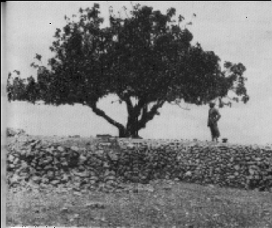
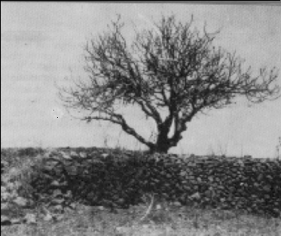
Historical Background
▸First Text
–Second Text
–Third Text
–Fourth Text

Slide 6
WHY ?
Deuteronomy 28:15 But it shall come to pass, if you do not obey the voice of the LORD your God, to observe carefully all His command-ments and
His statutes which I command you today, that all these curses will come upon you and overtake you:

Slide 7
Deuteronomy 28
28:42 "Locusts shall consume all your trees and the produce of your land.
Joel chapter 1
28:49 "The LORD will bring a nation against you from afar, from the end of the earth, [as swift] as the eagle flies, a nation whose language you will not understand,
Joel chapter 2

Slide 8
Day of the Lord
A “Day” or time when God intervenes in history
in a decisive way
to judge or deliver his people.

Slide 9
“Days of the Lord”
As given in Joel
Locust plague, 1:1-20 Past
586 B.C. destruction, 2:1-27 Future
Tribulation, 2:28--3:21 Future

Slide 10
3
Days of the Lord
2
1
Boom
(Tribulation)
Babylon
Bugs

Slide 11
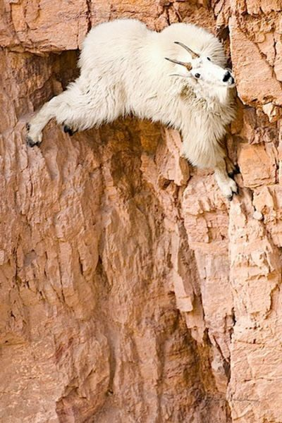
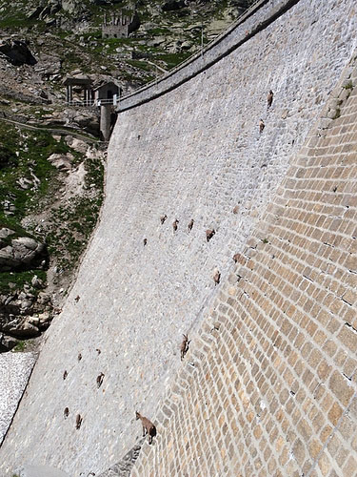
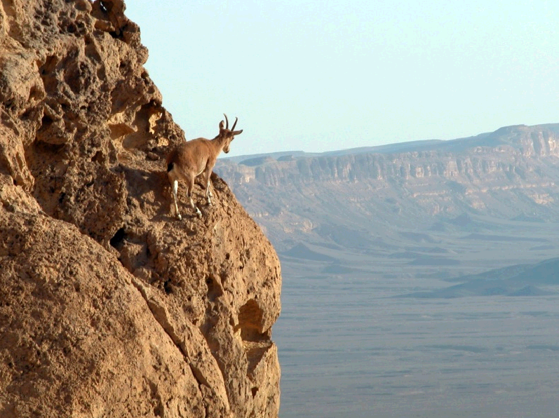
Habakkuk
A prophet’s
private conversation
with God

Slide 12
1C Question #1:Why do you allow such sin to continue among your people?
2 How long, O LORD, must I call for help,
but you do not listen?
Or cry out to you, “Violence!”
but you do not save?
3 Why do you make me look at injustice?
Why do you tolerate wrong?
Destruction and violence are before me;
there is strife, and conflict abounds.

Slide 13
2C God’s Answer: I won’t!
I’ll destroy Judah! 1:5-11
5 “Look at the nations and watch—
and be utterly amazed.
For I am going to do something in your days
that you would not believe,
even if you were told.
6 I am raising up the Babylonians,
that ruthless and impetuous people,
who sweep across the whole earth
to seize dwelling places not their own.

Slide 14
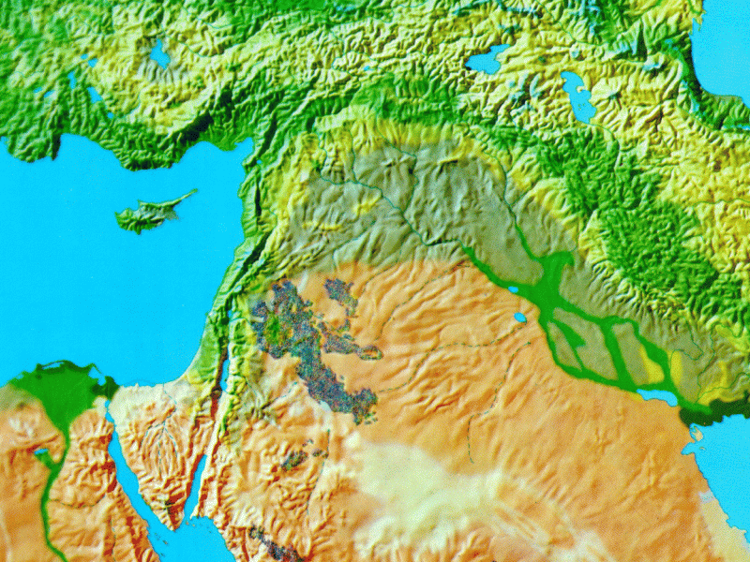
Assyria
Judah
Babylon

Slide 15
2B Question #2: Why will God use wicked Babylon to punish Judah?
12 O LORD, are you not from everlasting?
My God, my Holy One, we will not die (will we?).
O LORD, you have appointed them to execute judgment;
O Rock, you have ordained them to punish.
13 Your eyes are too pure to look on evil;
you cannot tolerate wrong.
Why then do you tolerate the treacherous?
Why are you silent while the wicked (Babylon)
swallow up those more righteous (Judah) than themselves?

Slide 16
3C The answer from God:
“Point taken Habakkuk!”
: I will also punish Babylon for her sin . . . eventually
(i.e., after they have destroyed Judah)” 2:2-20
4C Condemnation
1D Woe
2D Woe
3D Woe

Slide 17
Are we finished as a nation? (Chapter 3)
2B The answer by Habakkuk: a studied review of God’s work in the past 3:3-19
Habakkuk 3:3-4
3 God came from Teman,
the Holy One from Mount Paran. Selah
His glory covered the heavens
and his praise filled the earth.
4 His splendor was like the sunrise;
rays flashed from his hand,
where his power was hidden.

Slide 18
Habakkuk 3:5-6
5 Plague went before him;
pestilence followed his steps.
6 He stood, and shook the earth;
he looked, and made the nations tremble.
The ancient mountains crumbled
and the age-old hills collapsed.
His ways are eternal.
Habakkuk 3:8
8 Were you angry with the rivers, O LORD?
Was your wrath against the streams?
Did you rage against the sea
when you rode with your horses
and your victorious chariots?

Slide 19
Habakkuk 3:11
11 Sun and moon stood still in the heavens
at the glint of your flying arrows,
at the lightning of your flashing spear.
Habakkuk 3:13
13 You came out to deliver your people,
to save your anointed one.
You crushed the leader of the land of wickedness,
you stripped him from head to foot. Selah
Habakkuk 3:15
15 You trampled the sea with your horses,
churning the great waters.

Slide 20
Habakkuk 3:16
16 I heard and my heart pounded,
my lips quivered at the sound;
decay crept into my bones,
and my legs trembled.
Yet I will wait patiently for the day of calamity
to come on the nation invading us.

Slide 21
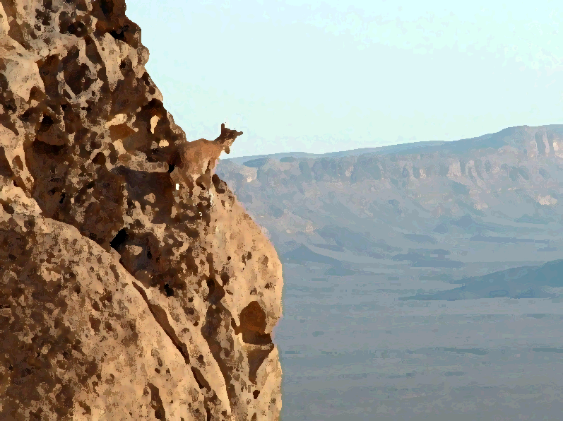
Habakkuk 3:17-18
17 Though the fig tree does not bud
and there are no grapes on the vines,
though the olive crop fails
and the fields produce no food,
though there are no sheep in the pen
and no cattle in the stalls,
18 yet I will rejoice in the LORD,
I will be joyful in God my Savior.
Habakkuk 3:19
19 The Sovereign LORD is my strength;
he makes my feet like the feet of a deer,
he enables me to go on the heights.

Slide 22
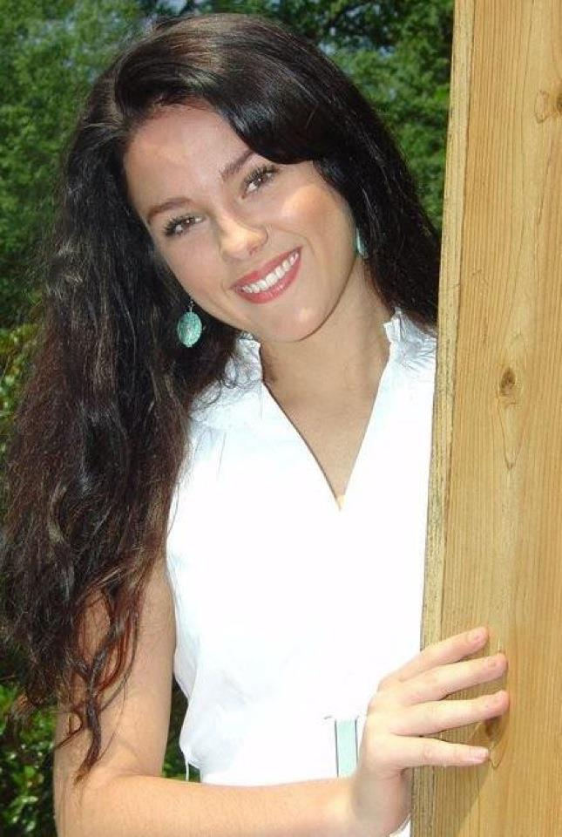
Habakkuk 3:17-18
17 Though the fig tree does not bud
and there are no grapes on the vines,
though the olive crop fails
and the fields produce no food,
though there are no sheep in the pen
and no cattle in the stalls,
18 yet I will rejoice in the LORD,
I will be joyful in God my Savior.
Habakkuk 3:19
19 The Sovereign LORD is my strength;
he makes my feet like the feet of a deer,
he enables me to go on the heights.

Slide 23
OBADIAH
It’s not the message but the timing

Slide 24
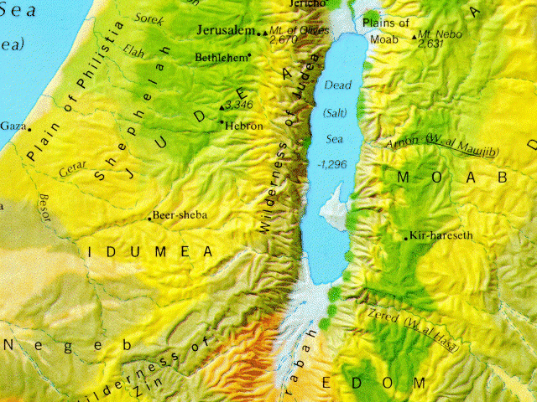
586

Slide 25
Obadiah 9
9 Your warriors, O Edom, will be terrified,
and everyone in Esau’s mountains
will be cut down in the slaughter.
10 Because of the violence against your brother Jacob,
you will be covered with shame;
you will be destroyed forever.
11 On the day you stood aloof
while strangers carried off his wealth
and foreigners entered his gates
and cast lots for Jerusalem,
you were like one of them.

Slide 26
Obadiah 13-15
13 You should not march through the gates of my people
in the day of their disaster,
nor look down on them in their calamity
in the day of their disaster,
nor seize their wealth
in the day of their disaster.
14 You should not wait at the crossroads
to cut down their fugitives,
nor hand over their survivors
in the day of their trouble.

Slide 27
Obadiah 15
15 “The day of the LORD is near
for all nations.
As you have done, it will be done to you;
your deeds will return upon your own head.
Bless those who bless you . . .
Curse those who curse you . . .

Slide 28
49
The Law
(Mosaic Covenant)
15
12
3:15
1-Sided
2-Sided
UNconditional
Conditional

Slide 29
Obadiah
12:1-3
12:1-3
12:1-3
I’m still cursing those who curse you,
because even though the Mosaic covenant may be broken
the promises to Abraham will never be forgotten
12:1-3
12:1-3

