Slide 1
Kings & Chronicles
How they’re different
and why they’re not really “just history”

Slide 2
Today’s agenda
We’ll compare Kings and Chronicles chronologically
We’ll look at a tale of two kings
We’ll look at the structure of the book of Kings
We’ll draw some conclusions about the author’s intent of Kings
We’ll introduce Chronicles

Slide 3
Chronological comparison of the “historical” books
1105 BC
1000
950
560
450
Samuel
Saul
David
Solomon
Jehoachin
Zerubbabel
1-2 Samuel
1-2 Kings
1-2 Chronicles
They don’t cover the same time
When they do cover the same events
they do it in different ways

Slide 4
A Tale of 2 Kings: 1) Manasseh, 2 Kings 21
Manasseh

Slide 5
A Tale of 2 Kings: 2) Solomon, 1 Kings 10:21—11:6
1 Kings 10:21
21 All King Solomon’s goblets were gold, and all the household articles in the Palace of the Forest of Lebanon were pure gold. Nothing was made of silver, because silver was considered of little value in Solomon’s days.
1 Kings 10:26
26 Solomon accumulated chariots and horses; he had fourteen hundred chariots and twelve thousand horses, which he kept in the chariot cities and also with him in Jerusalem.

Slide 6
A Tale of 2 Kings: 2) Solomon, 1 Kings 10:21—11:6
1 Kings 11:1
1 King Solomon, however, loved many foreign women besides Pharaoh’s daughter—Moabites, Ammonites, Edomites, Termites, Sidonians and Hittites.
1 Kings 11:2
2 They were from nations about which the LORD had told the Israelites, “You must not intermarry with them, because they will surely turn your hearts after their gods.” Nevertheless, Solomon held fast to them in love.
1 Kings 11:3
3 He had seven hundred wives of royal birth and three hundred concubines, and his wives led him astray.

Slide 7
A Tale of 2 Kings: 2) Solomon, 1 Kings 10:21—11:6
1 Kings 11:4
4 As Solomon grew old, his wives turned his heart after other gods, and his heart was not fully devoted to the LORD his God, as the heart of David his father had been.
1 Kings 11:5
5 He followed Ashtoreth the goddess of the Sidonians, and Molech the detestable god of the Ammonites.
1 Kings 11:6
6 So Solomon did evil in the eyes of the LORD; he did not follow the LORD completely, as David his father had done.

Slide 8
Why does the author so clearly display the failures of the kings?

Slide 9
Structure of the book: an important key to meaning

Slide 10
A Solomon’s Succession to the throne
B Solomon’s throne threatened
C Solomon’s wisdom
D Solomon’s reign characterized
E Solomon’s building projects
D Solomon’s reign characterized
C Solomon’s folly
B Solomon’s throne threatened
A Rehoboam’s Succession to the throne

Slide 11
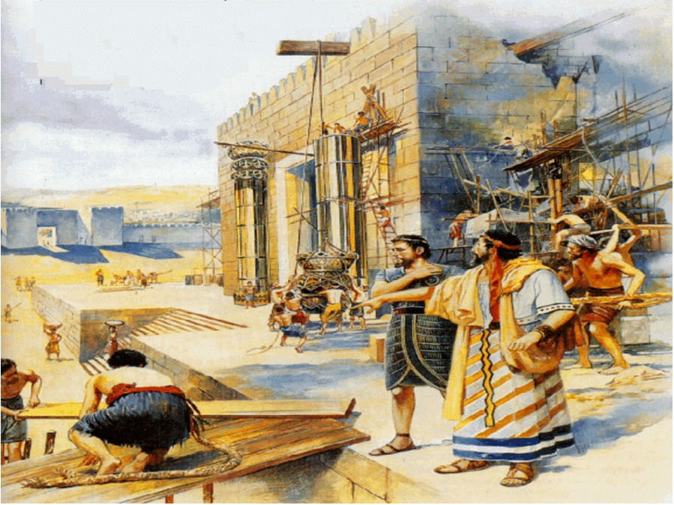
1 Kings 8:

Slide 12
1 Kings 8:
1 Kings 8:22-23
22 Then Solomon stood before the altar of the LORD in front of the whole assembly of Israel, spread out his hands toward heaven 23 and said:
“O LORD, God of Israel, there is no God like you in heaven above or on earth below—you who keep your covenant of love with your servants who continue wholeheartedly in your way.
1 Kings 8:29-30
29 May your eyes be open toward this temple night and day, this place of which you said, ‘My Name shall be there,’ so that you will hear the prayer your servant prays toward this place. 30 Hear the supplication of your servant and of your people Israel when they pray toward this place. Hear from heaven, your dwelling place, and when you hear, forgive.

Slide 13
1 Kings 8:
1 Kings 8:31-32
31 “When a man wrongs his neighbor and is required to take an oath and he comes and swears the oath before your altar in this temple, 32 then hear from heaven and act.
1 Kings 8:33-34
33 “When your people Israel have been defeated by an enemy because they have sinned against you, and when they turn back to you and confess your name, praying and making supplication to you in this temple, 34 then hear from heaven and forgive the sin of your people

Slide 14
1 Kings 8:
1 Kings 8:35-36
35 “When the heavens are shut up and there is no rain because your people have sinned against you, and when they pray toward this place and confess your name and turn from their sin because you have afflicted them, 36 then hear from heaven and forgive the sin of your servants, your people Israel.
1 Kings 8:37-39
37 “When famine or plague comes to the land, or blight or mildew, locusts or grasshoppers,39 then hear from heaven, your dwelling place. Forgive and act;

Slide 15
1 Kings 8:
1 Kings 8:46
46 “When they sin against you—for there is no one who does not sin—and you become angry with them and give them over to the enemy, who takes them captive to his own land, far away or near;
1 Kings 8:47
47 and if they have a change of heart in the land where they are held captive, and repent and plead with you in the land of their conquerors and say, ‘We have sinned, we have done wrong, we have acted wickedly’;

Slide 16
1 Kings 8:
1 Kings 8:48-49
48 and if they turn back to you with all their heart and soul in the land of their enemies who took them captive, and pray to you toward the land you gave their fathers, toward the city you have chosen and the temple I have built for your Name; 49 then from heaven, your dwelling place, hear their prayer and their plea, and uphold their cause.
1 Kings 8:50
50 And forgive your people, who have sinned against you; forgive all the offenses they have committed against you, and cause their conquerors to show them mercy;

Slide 17
The Goal of the Author?
Emphasis on Sin (tales of 2 kings)
Emphasis on Repentance (chap 8)
Outlines Deuteronomy 28-30, Repentance
Solution to exiled Israel’s problem:
The first call is here in Kings
The first response is Daniel (see Dan 9)

Slide 18
9:1 In the first year of Darius . . . who was made ruler over the Babylonian kingdom— 2 in the first year of his reign, I, Daniel, understood from the Scriptures, according to the word of the Lord given to Jeremiah the prophet, that the desolation of Jerusalem would last seventy years.
3 So I turned to the Lord God and pleaded with him in prayer and petition, in fasting, and in sackcloth and ashes.
4 I prayed to the Lord my God and confessed:
“Lord, the great and awesome God, who keeps his covenant of love with those who love him and keep his commandments, 5 we have sinned and done wrong. We have been wicked and have rebelled; we have turned away from your commands and laws. 6 We have not listened to your servants the prophets, who spoke in your name to our kings, our princes and our ancestors, and to all the people of the land.

Slide 19
“Therefore the curses and sworn judgments written in the Law of Moses, the servant of God, have been poured out on us, because we have sinned against you. 12 You have fulfilled the words spoken against us and against our rulers by bringing on us great disaster. Under the whole heaven nothing has ever been done like what has been done to Jerusalem.
13 Just as it is written in the Law of Moses, all this disaster has come on us, yet we have not sought the favor of the Lord our God by turning from our sins and giving attention to your truth. 14 The Lord did not hesitate to bring the disaster on us, for the Lord our God is righteous in everything he does; yet we have not obeyed him.

Slide 20
The Goal of the Author?
Emphasis on Sin (tales of 2 kings)
Emphasis on Repentance (chap 8)
Outlines Deuteronomy 28-30, Repentance
Solution to exiled Israel’s problem:
The first call is here in Kings
The first response is Daniel (see Dan 9)
But, there weren’t enough Daniels
A second call for this kind of repentance is heard from whom?

Slide 21
Summary
Kings is written to a hardened people in exile who need to be convinced of their own sin so they will repent.
Chronicles is a completely different ball game.

Slide 22
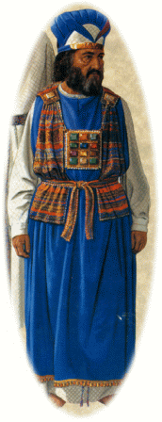
The Exile & After
Israel: A pale shadow of her former self

Slide 23
The Exile & After
Israel: A pale shadow of her former self
KING
from King to carpenter
Temple
from Porsche to Geo Metro
High Priest
from Urim & Thummim to Clueless
Holy of Holies
from Glory to empty

Slide 24
Chronicles
Idealization of David & Solomon
no mention of the reign in Hebron
Uriah & Bathsheeba . . . missing
rape of Tamar? Gone.
death of Absalom, Amnon?
Ends with emphasis upon the return from the exile
Lot’s of genealogies!

Slide 25
Summary
Kings is written to a hardened people in exile who need to be convinced of their own sin so they will repent:
Chronicles is written to spiritually discouraged believers, who have returned to the land, in order to encourage them to worship Yahweh at his Temple.

