Slide 1
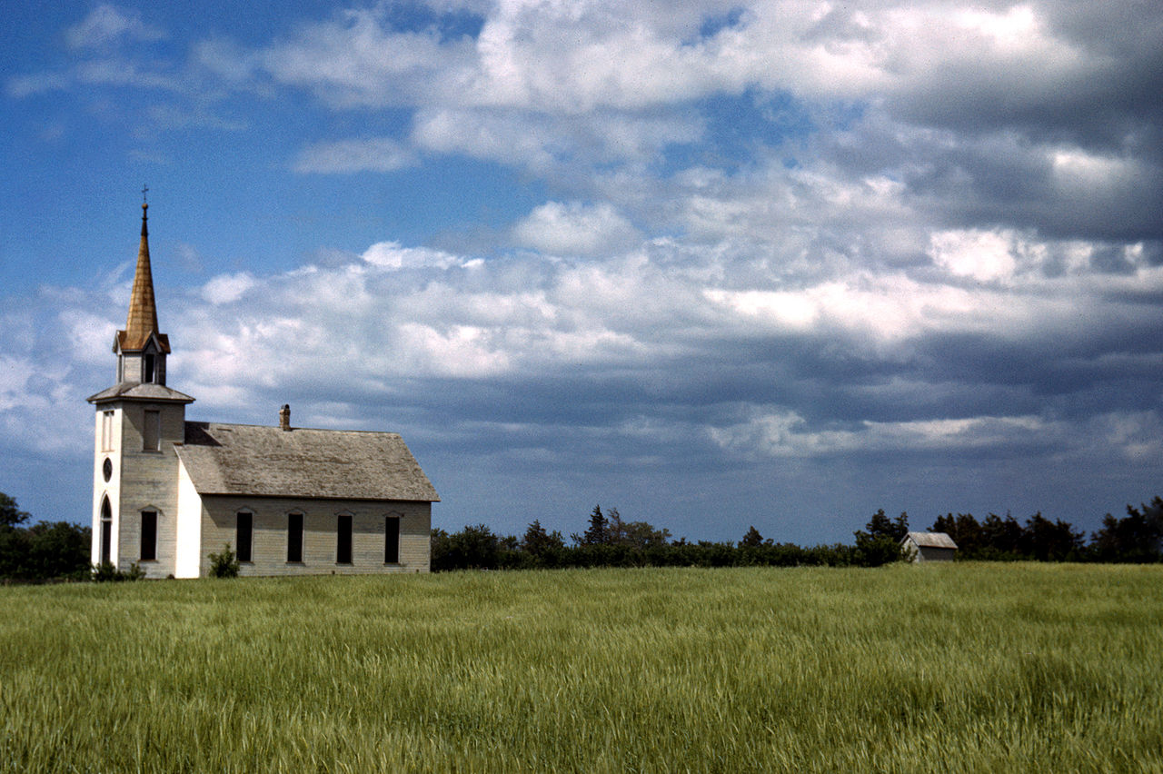
Ecclesiology: The Doctrine of the Church
Notes:
Illustration: here is the church, there is the steeple, open it up and there are the people

Slide 2
Defining the Term Church
Ekklesia: ek meaning “out” and kaleo meaning “called.” The called out ones.
Originally used in Greek city-states meaning “assemblies of citizens called out to conduct the business of the city.”
In the New Testament, the two English translations are 1) “assembly” and 2) “church.”

Slide 3
Defining the Term Church
Old Testament: (Septuagint) ekklesia is never used for edah (the nation as a whole) but is used 77 times for qahal (ceremonial assembly).
The emphasis on assembly has theological implications.
Notes:
Focus on assembly and implications for the multisite and the multiple services that some churches find necessary

Slide 4
Defining the Term Church
New Testament: 114 occurrences of ekklesia. 109 refer to a Christian assembly.
General Use
Future and Final Use: universal church
Local and Concrete Use: about 90% of all uses
The focus on the local, visible assembly has theological implications.
Notes:
Focus on local 90%: general use of family…universal church never meets.

Slide 5
Defining the Term Church
Metaphors: Paul Minear in his book, Images of the Church in the New Testament points out three central metaphors of his 100.
The People of God
The Body of Christ
The Fellowship of the Spirit
Notes:
Corporate images. The NT knows nothing of individual Christianity…the consumer driven approach is not mentioned.

Slide 6
Defining the Term Church
Toward a Definition of a True Church
Being (esse) Well-Being (bene esse)
Gospel Regenerate Church Membership
Believers covenanted together Meaningful Church Membership
Ordinances Church discipline
Officers (pastor and deacon)
Baptism by immersion of believers
Memorial view of the Lord’s Supper Missionary focus
Expositional preaching, etc.
Notes:
Dever has identified 9 Marks of a healthy church. Feel free to dig deeper there. Cultural Christianity is bad…some of our students may be unsaved.

Slide 7
Warning:
If you are squeamish, don’t look at the next slide
Notes:
Meaningful membership

Slide 8
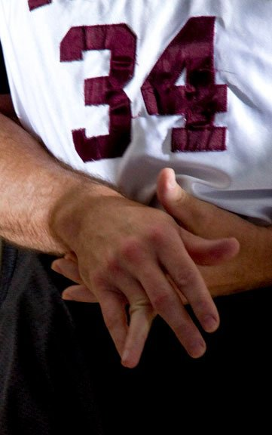
Membership Matters

Slide 9
Defining the Term Church
Toward a Definition of a True Church
Being (esse) Well-Being (bene esse)
Gospel Regenerate Church Membership
Believers covenanted together Meaningful Church Membership
Ordinances Church discipline
Officers (pastor and deacon)
Baptism by immersion of believers
Memorial view of the Lord’s Supper Missionary focus
Expositional preaching, etc.
Notes:
Healthy churches: discipline, for believers, expositional preaching, congregational, pastors (plurality), deacons (deaconess), ordinances (footwashing), toddler baptism, University does not practice the ordinances.

Slide 10
Practical Application
The University serves the church. We are not the church, and we do not lord over the church.
If our graduates do not love the church, then we are doing something very wrong.
Church membership has implications for hiring.
Local church doctrinal commitments have implications for us.
We must love the church in order to teach our students to do so. We expect attendance at a minimum of 90% of the time.

