Slide 1
We’re on a roll now!

Slide 2
Historical Setting of the Book
If you sold real-estate in Jericho in 1445 BC ☺,
what would the state of the market be, and
what would you do?

Slide 3
You
Are
HERE
Sinai,
Leviticus
Joshua’s
Exodus
Wilderness
entry
1446
1445
1406

Slide 4
The book in a nutshell
The next steps toward the promises are initiated by God
but are delayed by Israel's unfaithfulness.
At least they’re postponed, not cancelled.
Land
Nation
Leader

Slide 5
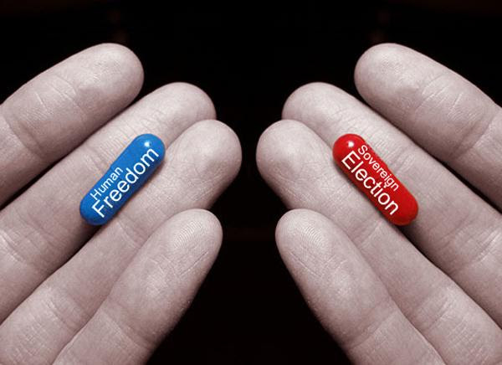
Preview
Israel’s
Rebellion
God’s
Promises
How does human responsibility influence / affect God’s sovereignty?
How does my foolishness or my faithfulness influence / affect God’s plan for my life?
Notes:
Our sinfulness can twist the doctrine of the faithfulness of God. Our sinfulness can take a very utilitarian / consumer approach toward God, treating his grace as a commodity to be traded and utilized.

Slide 6
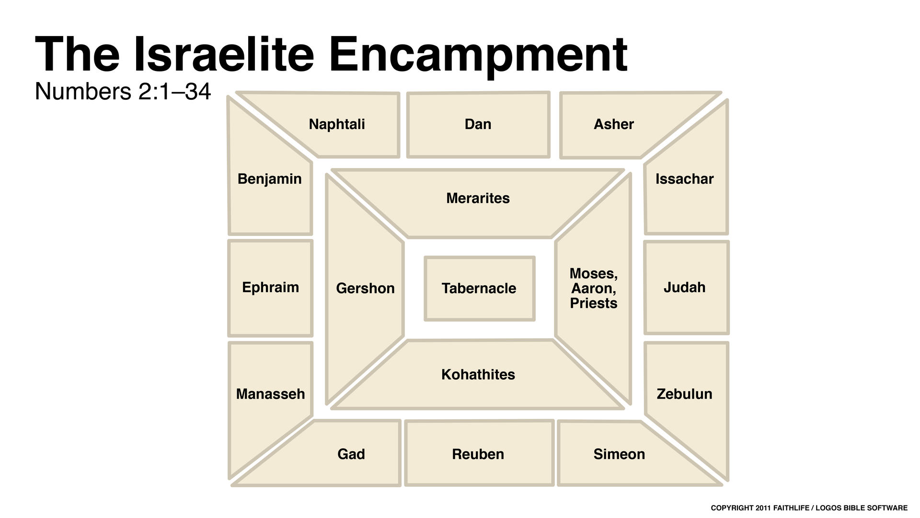
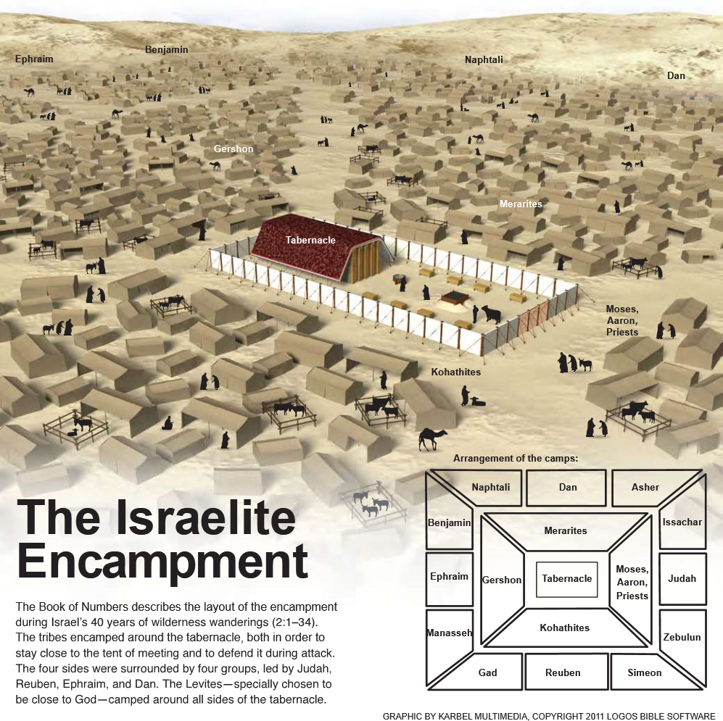
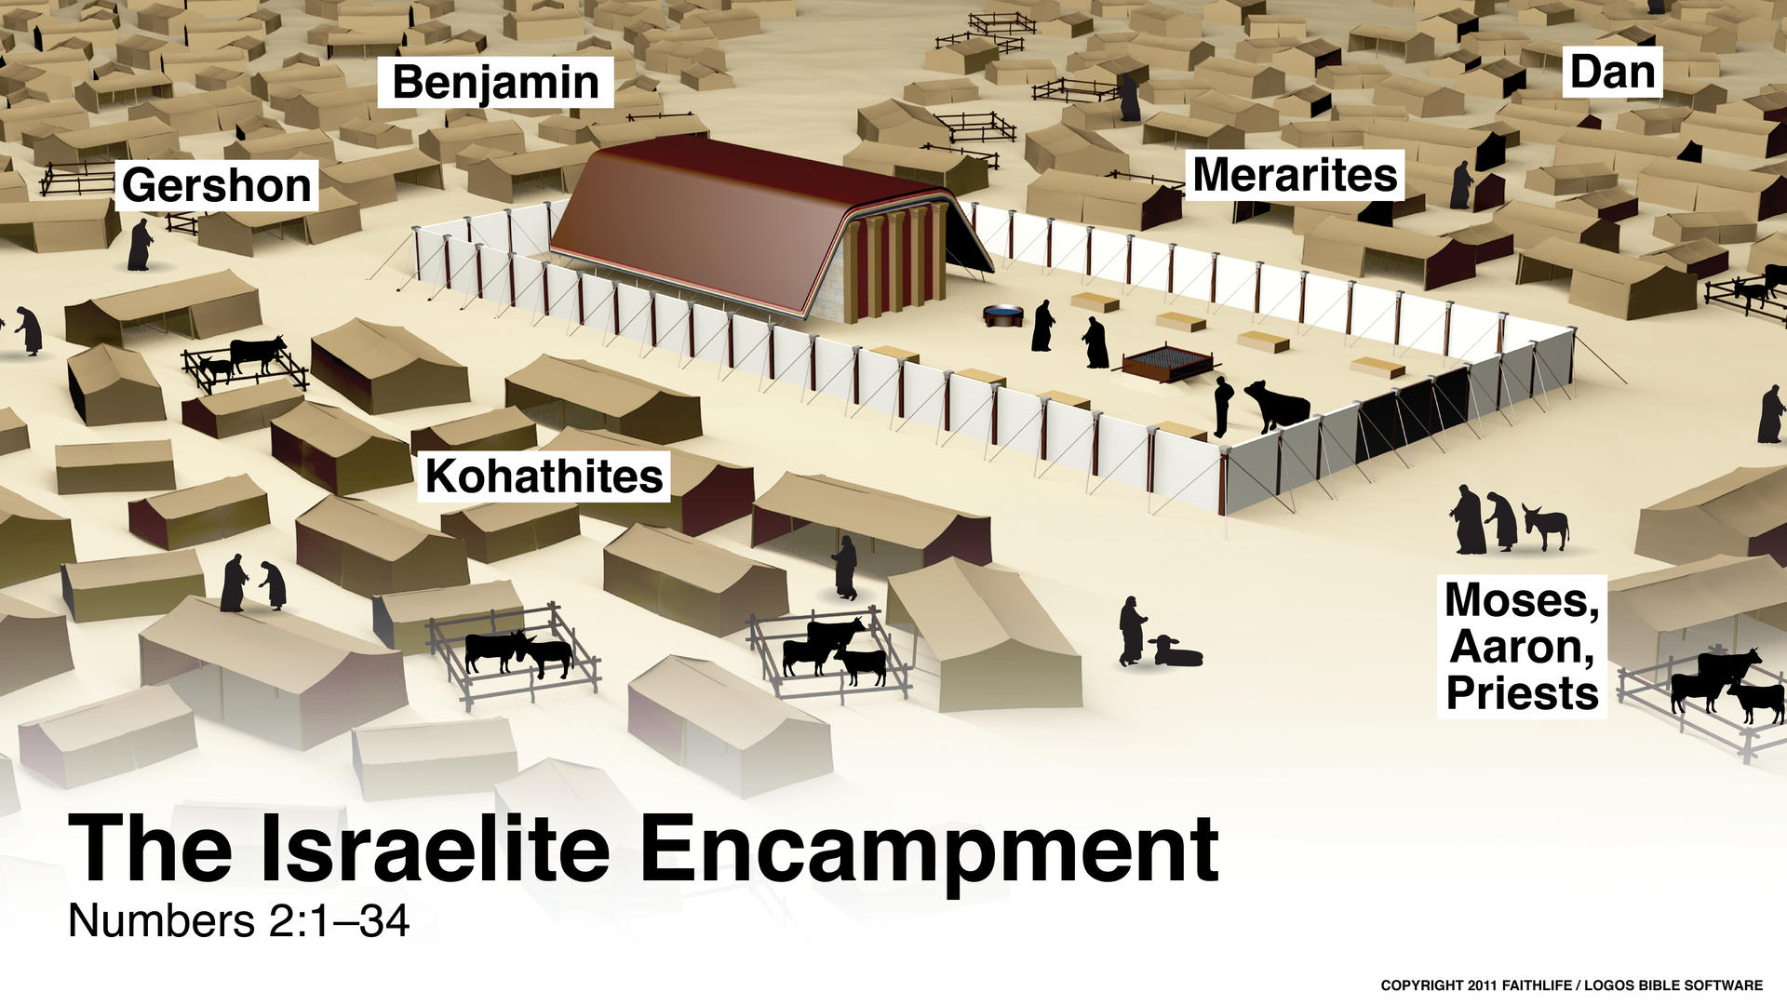
1A Israel’s Camp Ordered by God, 1--10
1B The commands for Order, 1-4

Slide 7
1A Israel’s Camp Ordered by God, 1--10
1B The commands for Order, 1-4
What He asks
is not difficult.
What is repeated
is simply that
the people do it!
And it makes
for a very happy
relationship !!!

Slide 8
1A Israel’s Camp Ordered by God, 1--10
1B The commands for Order, 1-4
Numbers 1:19 as the LORD commanded Moses. And so he counted them in the Desert of Sinai:
Numbers 1:54 The Israelites did all this just as the LORD commanded Moses.
Numbers 2:34 So the Israelites did everything the LORD commanded Moses; that is the way they encamped under their standards, and that is the way they set out, each with his clan and family.
Numbers 3:51 Moses gave the redemption money to Aaron and his sons, as he was commanded by the word of the LORD.
Numbers 4:49 At the LORD’s command through Moses, each was assigned his work and told what to carry. Thus they were counted, as the LORD commanded Moses.

Slide 9
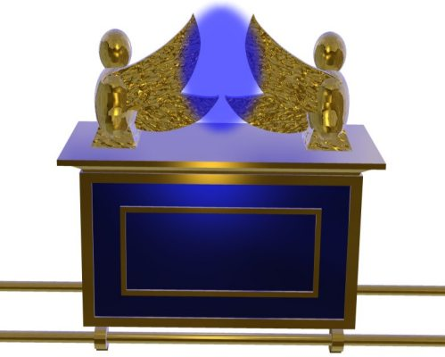
2B The commands for purity 5-10
1C Regulations against defilement, 5
Numbers 5:4 The Israelites did this; they sent them outside the camp. They did just as the LORD had instructed Moses.
4C, Response of a Pure people, 7
Numbers 7:89 When Moses entered the Tent of Meeting to speak with the LORD, he heard the voice speaking to him from between the two cherubim above the atonement cover on the ark of the Testimony. And he spoke with him.

Slide 10
5C
Numbers 8:4 This is how the lampstand was made: It was made of hammered gold—from its base to its blossoms. The lampstand was made exactly like the pattern the LORD had shown Moses.
Numbers 8:20 Moses, Aaron and the whole Israelite community did with the Levites just as the LORD commanded Moses.
6C
Numbers 9:5 and they did so in the Desert of Sinai at twilight on the fourteenth day of the first month. The Israelites did everything just as the LORD commanded Moses.
7C
Numbers 9:23 At the LORD’s command they encamped, and at the LORD’s command they set out. They obeyed the LORD’s order, in accordance with his command through Moses.

Slide 11
Israel’s Failure & Sin
cause a delay
in God’s program
for them

Slide 12
Israel’s Failure & Sin
cause a delay
in God’s program
for them

Slide 13
1A Israel’s Camp Ordered by God, 1-10,
2A Israel’s Walk Disrupted, 10-21
1B The Journey, 10-14
1C Moses’ lack of faith (?) in God’s direction, 10:29-31
2C The peoples’ complaint on the outskirts, 11:1-3
3C The peoples’ complaint about food, 11:4-10
4C Miriam & Aaron’s complaint against Moses, 12
5C The nation rebels against God’s direction to enter the land, chapters 13-14
Notice the development of the attitude and the progression of the sin…
BACKGROUND

Slide 14
2C The outskirts
3C At every tent
4C At the heart of the leadership
5C Deliberate, callous decision on the part of the whole nation

Slide 15
Philippians 2: The Seriousness
⁸ And being found in appearance as a man,
he humbled himself
and became obedient to death—
even death on a cross!
⁹ Therefore God exalted him to the highest place
and gave him the name that is above every name,
¹⁰ that at the name of Jesus every knee should bow,
in heaven and on earth and under the earth,
¹¹ and every tongue confess that Jesus Christ is Lord,
to the glory of God the Father.
¹² Therefore, my dear friends, as you have always obeyed—not only in my presence, but now much more in my absence—continue to work out your salvation with fear and trembling, ¹³ for it is God who works in you to will and to act according to his good purpose.
¹⁴ Do everything without complaining or arguing, ¹⁵ so that you may become blameless and pure, children of God without fault in a crooked and depraved generation, in which you shine like stars in the universe

Slide 16
Hebrews 3: The Solution
⁷ So, as the Holy Spirit says:
“Today, if you hear his voice,
⁸ do not harden your hearts
as you did in the rebellion,
during the time of testing in the desert,
⁹ where your fathers tested and tried me
and for forty years saw what I did.
¹⁰ That is why I was angry with that generation,
and I said, ‘Their hearts are always going astray,
and they have not known my ways.’
¹¹ So I declared on oath in my anger,
‘They shall never enter my rest.’”
¹² See to it, brothers, that none of you has a sinful, unbelieving heart that turns away from the living God.
¹³ But encourage one another daily, as long as it is called Today, so that none of you may be hardened by sin’s deceitfulness.
Num
13-14

Slide 17
1A Israel’s Camp Ordered by God, 1-10,
2A Israel’s Walk Disrupted, 10-21
1B The Journey, 10-14
1C Moses’ lack of faith (?) in God’s direction
2C The peoples’ complaint on the outskirts
3C The peoples’ complaint about food
4C Miriam & Aaron’s complaint against Moses
5C The nation rebels against God’s direction to enter the land
Notice the development of the attitude and the progression of the sin…
Notice the deliberateness of the sin and the wording of the judgment…

Slide 18
deliberateness of the sin
Who are these “Anakites” ? (13:27—32)
Everyone is against J & C (14:2, 10)
Note the exception for Caleb
14:24 “But because my servant Caleb has a different spirit and follows me wholeheartedly, I will bring him into the land he went to, and his descendants will inherit it.”

Slide 20
Imagine 40 years here !
Does God remember?

Slide 21
3A Israel’s Walk is Assured by God’s Promise to Abraham
1B God blesses Israel Through Balaam and Protects her from unknown Danger, 22—24
Balak (”k” stands for King) asks Balaam (”m” stands for Malicious prophet) to curse Israel
“For I know that those you bless are blessed, and those you curse are cursed” 22:6
1 “I will give you the land ...”
2 ‘‘I will make you into a great nation
and I will bless you...
3 I will bless those who bless you,
and whoever curses you I will curse;
and all peoples on earth
will be blessed through you.”
Land
Nation
Leader

Slide 22
3A Israel’s Walk is Assured by God’s Promise to Abraham
1B God blesses Israel Through Balaam and Protects her from unknown Danger, 22—24
Balak (”k” stands for King) asks Balaam (”m” stands for Malicious prophet) to curse Israel
“For I know that those you bless are blessed, and those you curse are cursed” 22:6
1 “I will give you the land ...”
2 ‘‘I will make you into a great nation
and I will bless you...
3 I will bless those who bless you,
and whoever curses you I will curse;
and all peoples on earth
will be blessed through you.”
Land
Nation
Leader

Slide 23
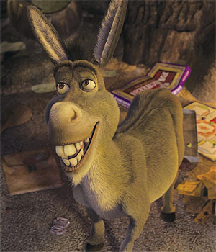
2 Peter 2: Balaam is a polytheistic, sorcerer, false-prophet kind of guy.
What’s the deal with the talking donkey?
Hmmm … so Balaam, you’re a really hot speaker, huh??
if this is a contest of who is the more powerful speaker, then let’s go!

Slide 24
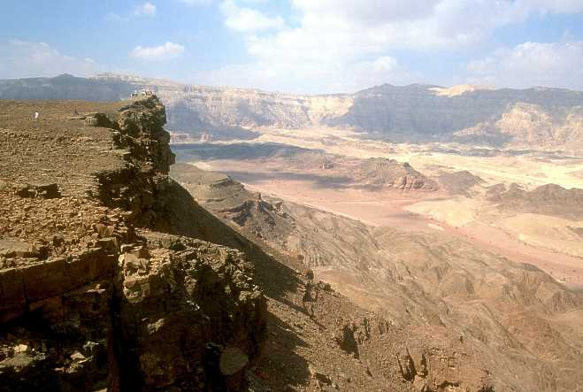
“Curse” #1
Numbers 23:9-10
9 From the rocky peaks I see them, from the heights I view them. I see a people who live apart and do not consider themselves one of the nations.
10 Who can count the dust of Jacob or number the fourth part of Israel?
Let me die the death of the righteous, and may my end be like theirs!”
Balaam
Israel
Ex 19:5 And now, if you will diligently obey me and keep my covenant, then you will be my special possession out of all the nations, for all the earth is mine. 19:6 And you will be my kingdom of priests and a holy nation.’
Gen 28:13 He said, “I am the Lord, the God of your grandfather Abraham and the God of your father Isaac. I will give you and your descendants the ground you are lying on. 28:14 Your descendants will be like the dust of the earth, and you will spread out to the west, east, north, and south.

Slide 25
“Curse” #2
Numbers 23:19
19 God is not a man, that he should lie,
nor a son of man, that he should change his mind.
Does he speak and then not act?
Does he promise and not fulfill?
Land
Nation
Leader

Slide 26
“Curse” #3
Numbers 24:9 Like a lion they crouch and lie down,
like a lioness—who dares to rouse them?
“May those who bless you be blessed
and those who curse you be cursed!”
Land
Nation
12
Leader

Slide 27
Curse #4
Numbers 24:17 “I see him, but not now;
I behold him, but not near.
A star will come out of Jacob;
a scepter will rise out of Israel.
He will crush the foreheads of Moab, the
skulls of all the sons of Sheth.
Land
Nation
12
Leader
3:15

Slide 28
2B God Judges Israel for Intentional Sin, 25
God will protect you from things that you can't protect yourself from (chap 23-24), but you will feel the discipline of the Lord when you choose self-destructive ways (chap 25).

Slide 29
God’s Unconditional & Conditional Love
Not a contradiction, or mysterious antinomy
Rather normal part of the personality of a complex being
Jude 21: Keep yourselves in God’s love as you wait for the mercy of our Lord Jesus Christ to bring you to eternal life.
John 14:23 Jesus replied, “If anyone loves me, he will obey my teaching. My Father will love him, and we will come to him and make our home with him.”
Luke 15, Prodigal son, Father
Notes:
No anger, but disappointment, please, I want to do good things or you and you’re not letting me do that right now.

Slide 30
God’s Unconditional & Conditional Love
Not a contradiction, or mysterious antinomy
Rather normal part of the personality of a complex being
Home
More Love ?
Far country
Unconditional Love

