Slide 1
Judges & Ruth
A 2-part masterpiece
of Redemption

Slide 2
4C The passing of leadership 24:28-33
Land
Nation
Leader
v. 32

Slide 3
Structure
The nifty way the author helps us understand the major pieces of his book . . .
3 Major parts
1-3, Scary preview of the book
3-16, Downward spiral of the Judges
17-21, Two perfect stories
Special note: The judges are neither chronologically consecutive nor geographically comprehensive.
Another reason not to treat this as a strict “history” of the period but as a carefully crafted literary work with messages to tell.

Slide 4
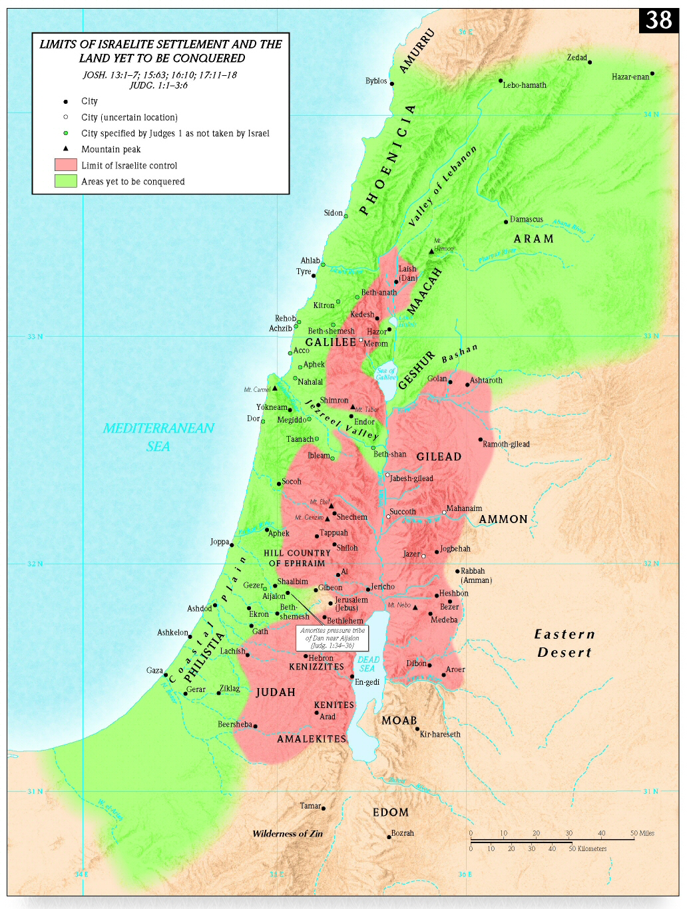
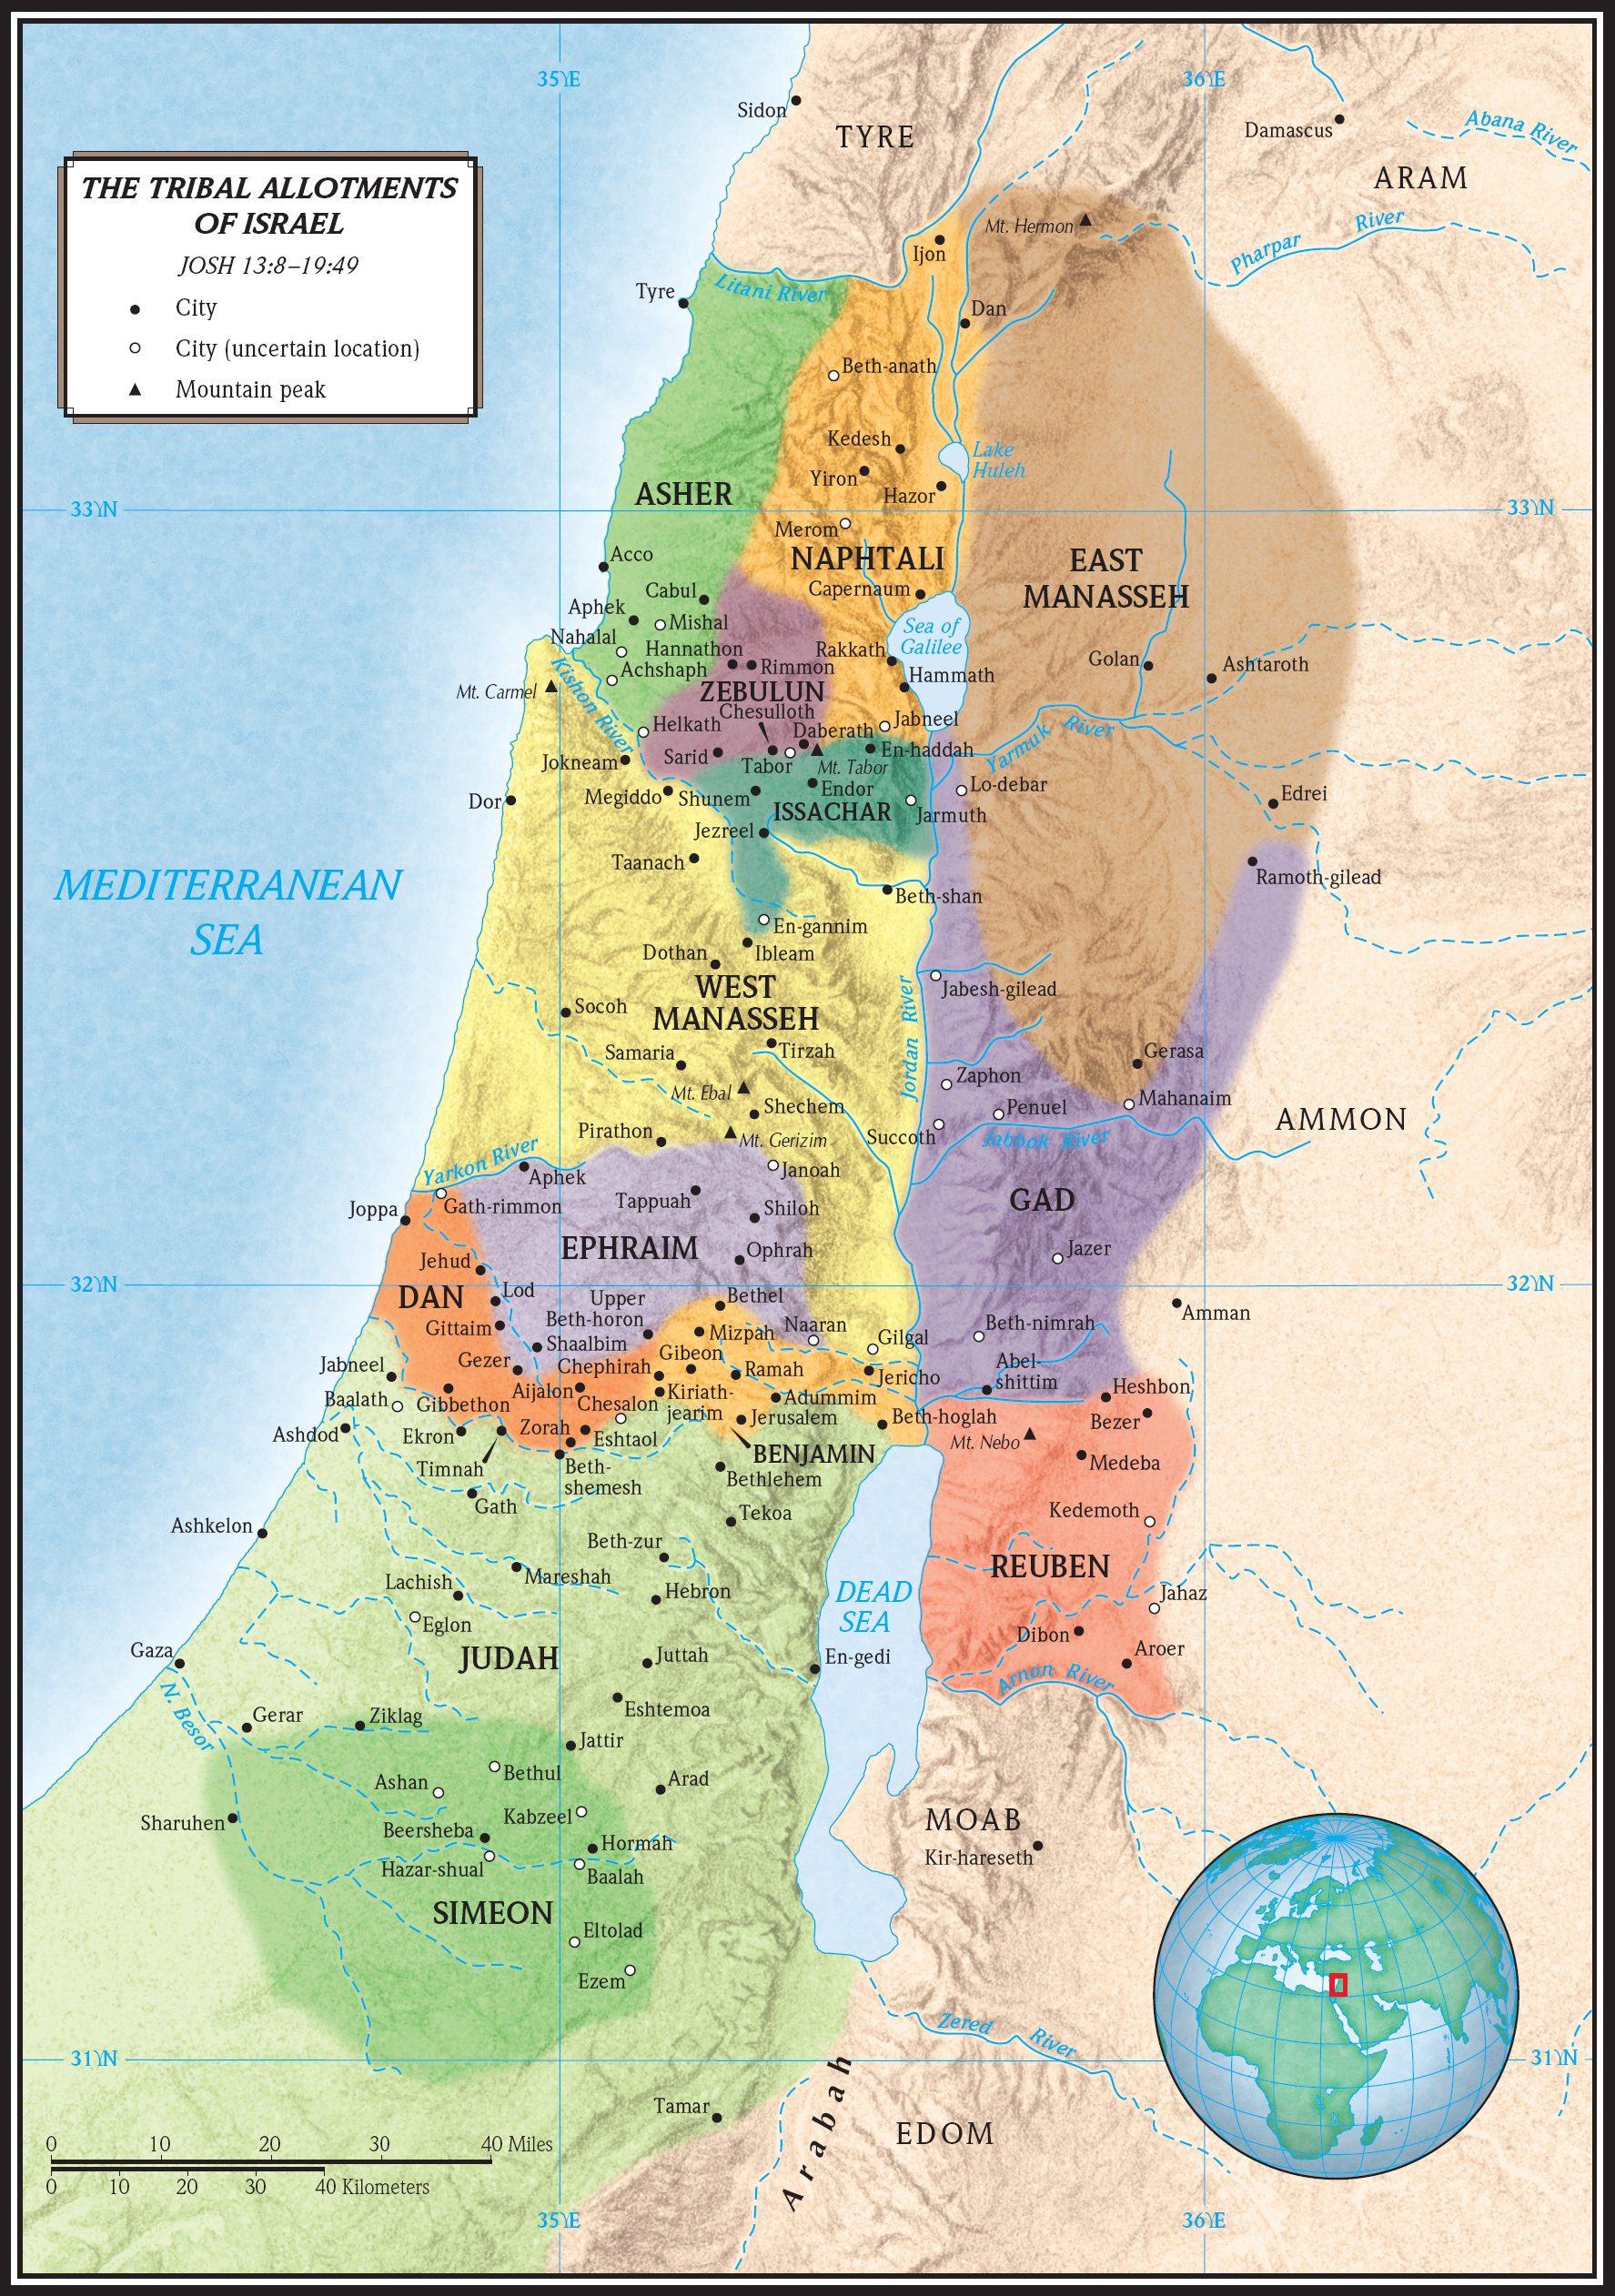

Slide 5
1A Israel’s Incomplete Conquest 1-3
1B Israel’s Disobedience, 1:1--2:5
1C Israel’s failure to drive out the inhabitants 1
1:1-18 Nice start!
1:19—oops.
2C God’s evaluation . . . 2:1-5
2:1-2 “I said, ‘I will never break my covenant with you, and you shall not make a covenant with the people of this land, but you shall break down their altars. Yet you have disobeyed me. Why have you done this?”
2B Self-destructive patterns of operation, 2:6-- 3:6

Slide 6
“The cycle”
Sin
Deliverance
Oppression
Distress
2:16 “Then the Lord raised up judges, who saved them out of the hands of these raiders.”
2:14“In his anger against Israel the Lord handed them over”
2:11 “Then the Israelites did evil in the eyes of the Lord and served the Baals”
2:15 “They were in great distress”

Slide 7
“The cycle”
Sin
Deliverance
Oppression
Distress
2:19 But when the judge died, the people returned to ways even more corrupt than those of their fathers, following other gods and serving and worshiping them.

Slide 8
“The cycle”
Ehud
Deborah
Jepthah
Samson
2:19 But when the judge died, the people returned to ways even more corrupt than those of their fathers, following other gods and serving and worshiping them.

Slide 9
As we move through the stories look for three things:
1) Progress from one story to the next, i.e., what changes take place?
2) Your own affective response, i.e., how does the story make me feel?
3) How does the role of women relate to the main theme?
2A God’s Mercy in Delivering 3-16
1B Othniel: The First Deliverer, 3:7-11
Mr. Short ‘n Sweet, Acsah’s hero
2B Ehud: The Lone Deliverer, 3:12-20
The Left-handed Lone Ranger
Progress?
Feel?
Women?

Slide 10
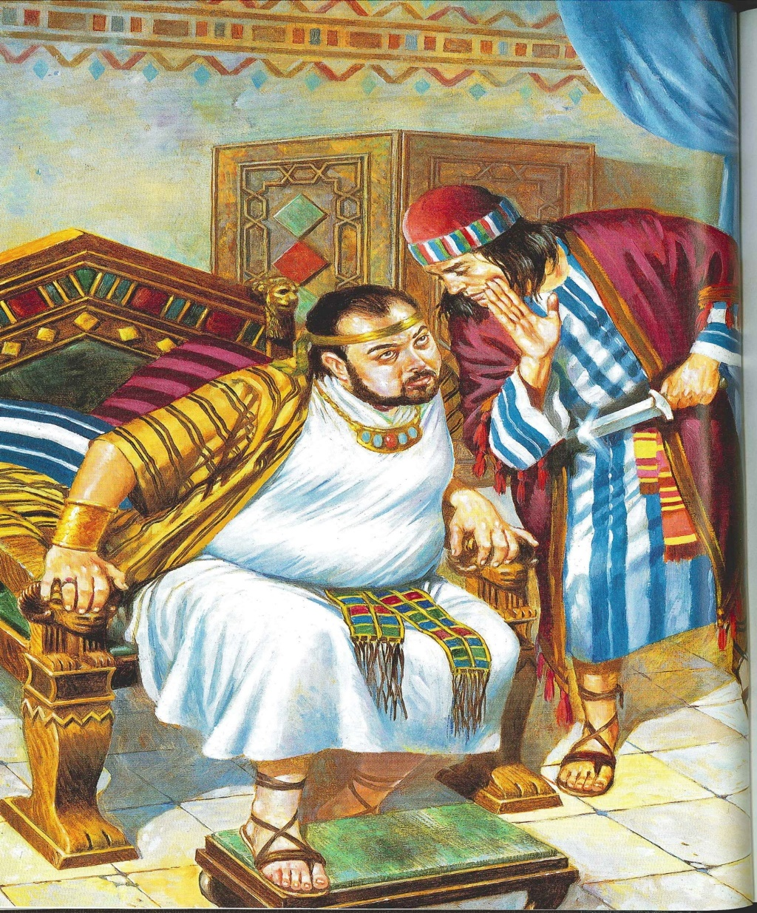
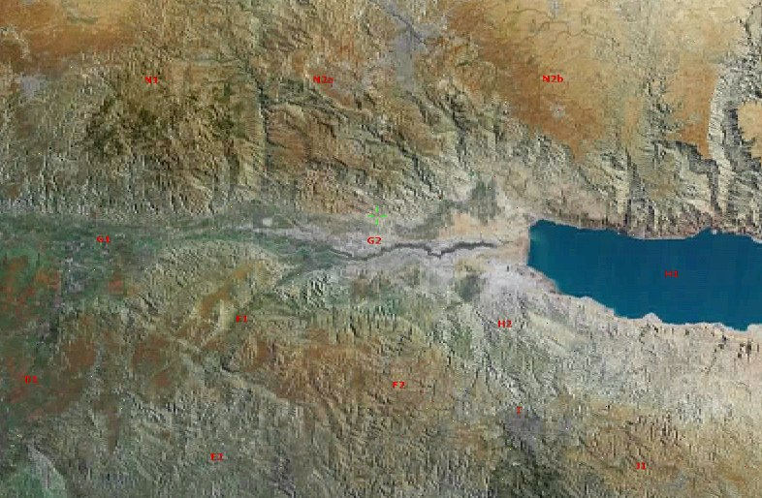
What kind of movie rating would this story deserve?
What kind of audience would like this?
What kind of change or progression do you see?
How does it make you feel?
How are women treated?
Moab
Israel

Slide 11
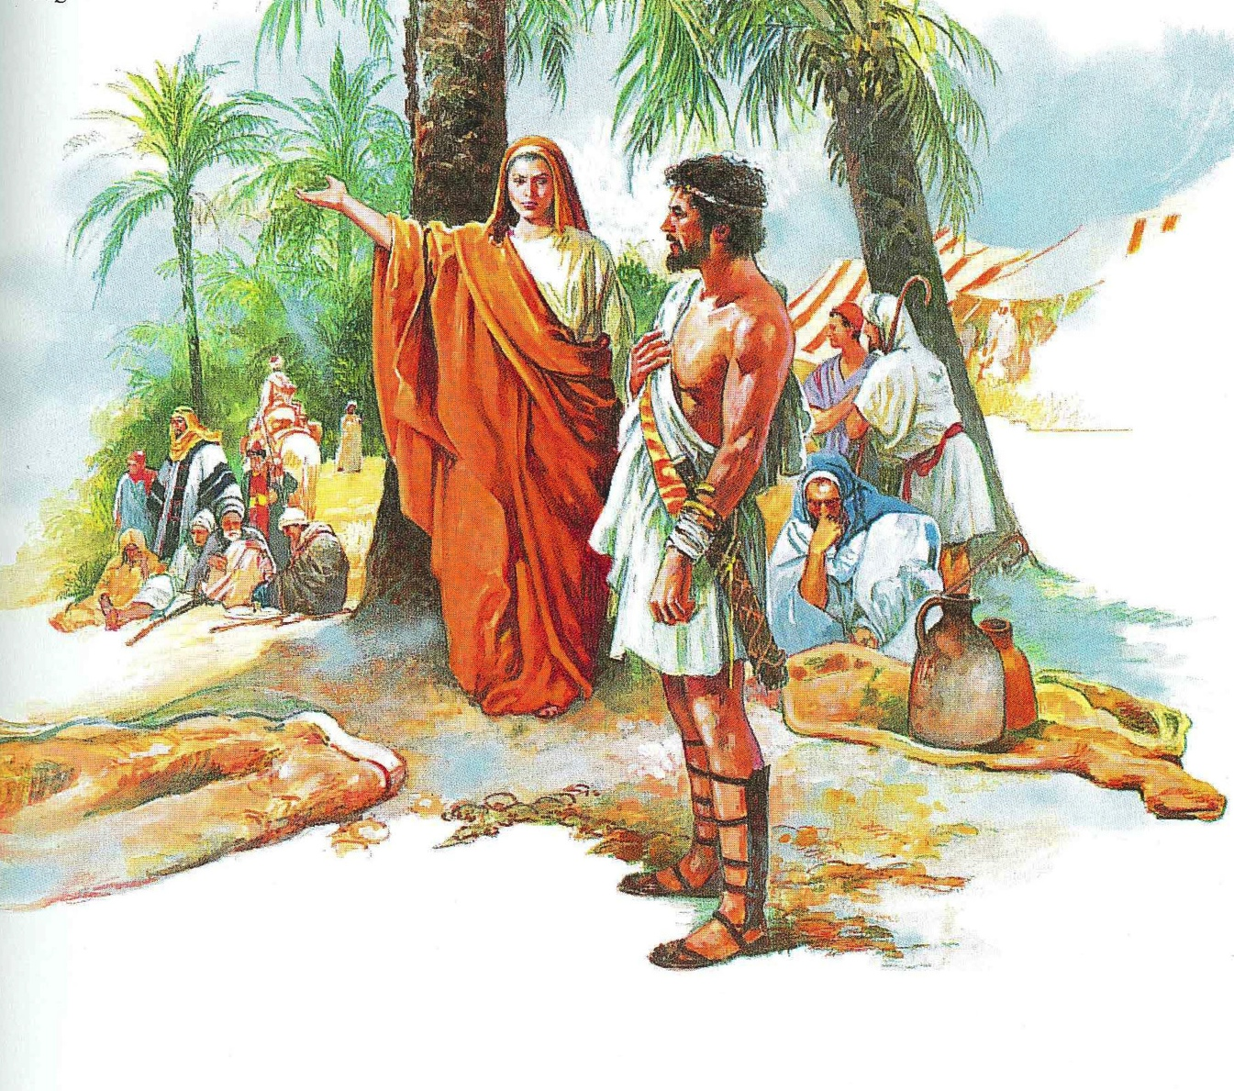
2A God’s Mercy in Delivering 3-16
3B Deborah: The Female Deliverer, 4-5
Jael & her deadly “nails”

Slide 12
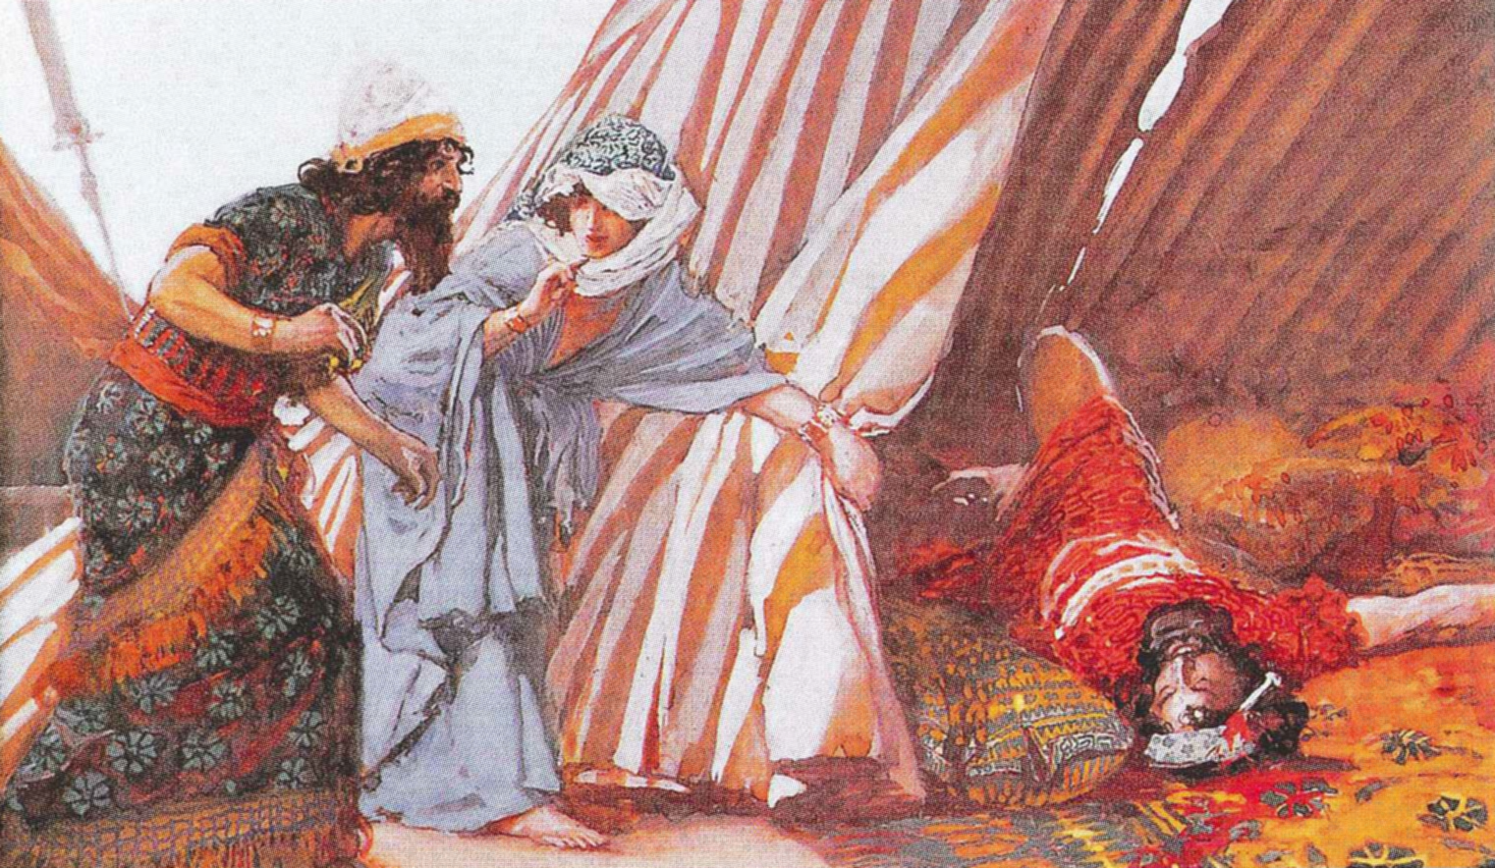
Jael & her deadly nails
Progress?
Feel?
Women?

Slide 13
4B Gideon: The Hesitant Deliverer, 6-10
1C Gideon
1D The LORD (not Baal) is the God of Israel, 6--8:21
2D The LORD (not Gideon) is the King of Israel, 8:22-28

Slide 14
“Please be our king”
What they had
What they wanted
What they eventually got
God
Gideon
God
David

Slide 15
4B Gideon: The Hesitant Deliverer, 6-10
1C Gideon
1D The LORD (not Baal) is the God of Israel, 6--8:21
2D The LORD (not Gideon) is the King of Israel, 8:22-28
3D BUT 8:24—35!

Slide 16
4B Gideon: The Hesitant Deliverer, 6-10
1C Gideon
  1D The LORD is the God of Israel, 6-8:21
  2D The LORD is the King of Israel, 8:22-28
2C Abimelech: The wicked deliverer, 9:1--9:57
  He acts out that Baal is the God of Israel
  He acts out that He is the King of Israel
  Abimelech lives out the tendencies of his father
5B Jephthah: The Impulsive Deliverer, 10-12
“A Boy named ‘Sue’”
11:30 “Jephthah made a vow to the Lord, ‘If you give me the Ammonites into my hands, whatever comes out of the door of my house to meet me when I return . . . will be the LORD’S and I will sacrifice it as a burnt offering.’”
11:39 “and he did to her as he had vowed.”

Slide 17
Samson
6B The Self-centered Deliverer, 13-16
1C His miraculous birth, 13:1-25
Congratulations! “It’s a Nazirite”
No grapes because
we’ll be in control at all times…
No haircuts because
we’ll be unashamed of our dedication
No dead things because
death & sin are enemies

Slide 18
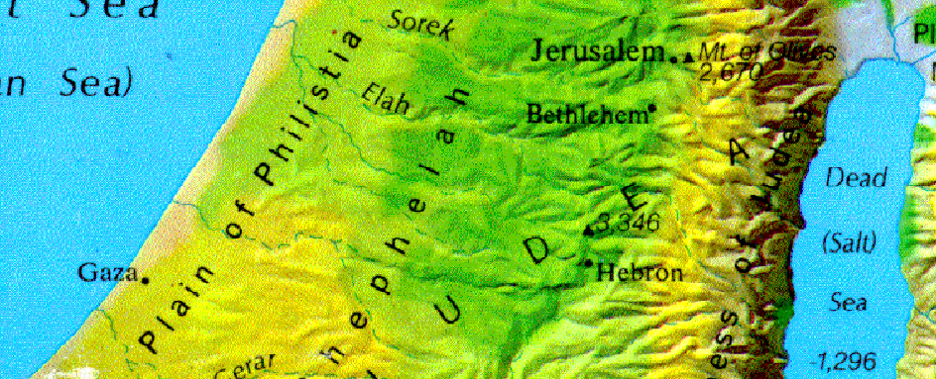
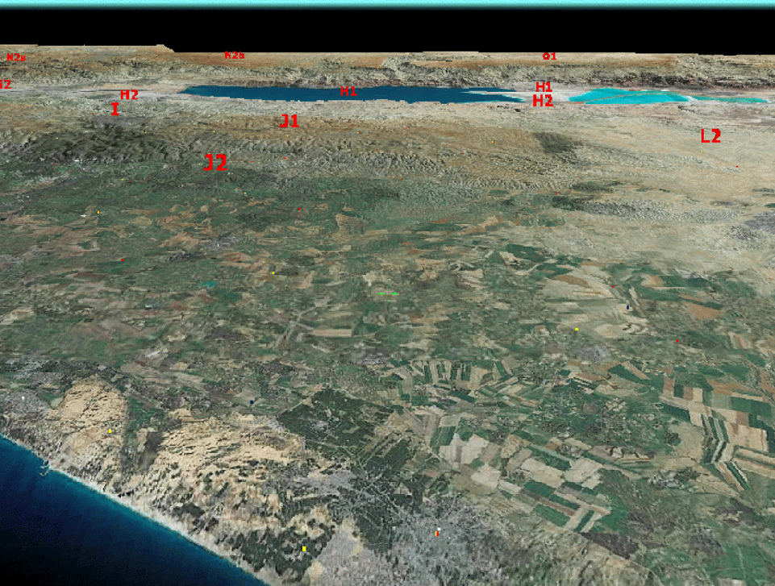
2C His marriage & vengeance on the Philistines, 14-15
Notice his view of women
3C His humiliation and vengeance on the Philistines, 16
Hebron
3,300 ft. UP
40 miles east
Gaza

Slide 19
2C His marriage & vengeance on the Philistines, 14-15
3C His humiliation and vengeance on the Philistines, 16
“I’ll get revenge because of my eyes”
“Who is this that insults the armies of the Living God?”
Notes:
The “spiritually and physically” blind leading the “spiritually” blind.

Slide 20
3A Religious & Moral Disorder, 17—21
Two perfect stories . . .
Judges 17:6 In those days there was no king in Israel, but every man did that which was right in his own eyes. (KJV)

Slide 21
Judges 17:6 In those days there was no king in Israel, but every man did that which was right in his own eyes. (KJV)
Is there a cause & effect relationship?
Judges 18:1 In those days there was no king in Israel:
Judges 19:1 And it came to pass in those days, when there was no king in Israel,
Judges 21:25 In those days there was no king in Israel: every man did that which was right in his own eyes.

Slide 22
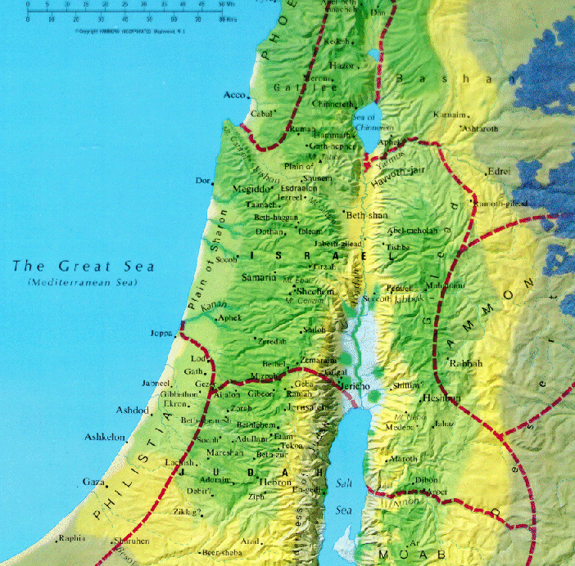
3A Religious & Moral Disorder
1B Corruption in Worship, 17--18
Major players
Micah, Levite from Bethlehem, tribe of Dan

Slide 23
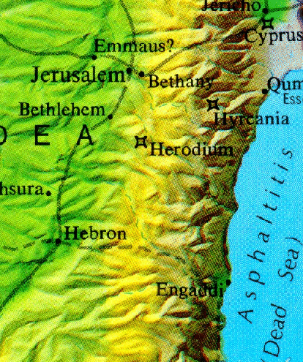
3A Religious & Moral Disorder
1B Corruption in Worship, 17--18
2B Corruption in Morals, 19--21
1C The Wickedness of Benjamin, 19
2C The destruction of Benjamin, 20
3C The provision for Benjamin, 21
    Jabesh-Gilead? So sorry...we need 400 orphans
    Girls at Shiloh for another 200
    What is wrong with this picture?
    What is right with this picture?
"godly"
Pagan

Slide 24
As we move through the stories look for three things:
1) Progress from one story to the next, i.e., what changes take place?
male leadership evaporates
2) Your own affective response, i.e., how does the story make me feel?
3) How does the role of women relate to the main theme?
Sick & Empty
Women especially suffer the effects of sin when the culture decays. The nation’s relationship with God is accurately measured by the treatment of women.

Slide 25


Judges 21:25 In those days there was no king in Israel: every man did that which was right in his own eyes.

Slide 26
Judges & Ruth
These two books are so different… one is about corruption in the nation, the other is about a personal love story. Are they connected in some way ???
“In the days when the judges ruled . . .” Ruth 1:1

Slide 27
1A Naomi Emptied, 1:1-5

Slide 28
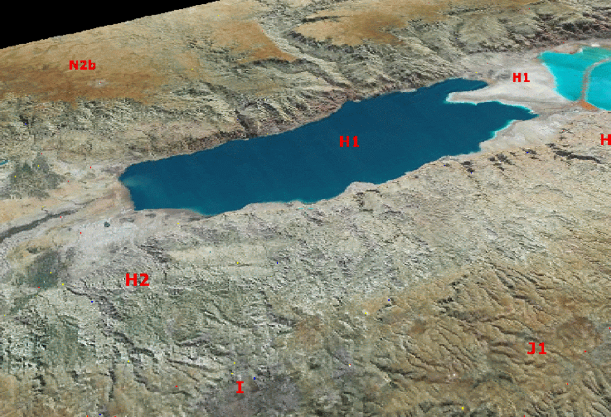
Moab
Bethlehem

Slide 29
1A Naomi Emptied, 1:1-5
2A Naomi Returns ... Moab, 1:6-22
  1B Ruth shows her loyalty, 1:6-18
  2B Ruth & Naomi return, 1:19-22
  20 “Don’t call me Naomi,” she told them. “Call me Mara, because the Almighty has made my life very bitter. 21 I went away full, but the Lord has brought me back empty.
3A Ruth & Boaz Meet, 2:1-23
  1B We meet Boaz: Ruth begins work, 2:1-7
  2:4 Just then Boaz arrived from Bethlehem and greeted the harvesters, “The LORD be with you!”
  “The LORD bless you!” they answered.
  2B Boaz shows kindness to Ruth, 2:8- 16
  2:8 So Boaz said to Ruth, “My daughter . . .
  3B Ruth returns to Naomi, 2:17-23

Slide 30
  3B Ruth returns to Naomi, 2:17-23
  2:20 “The LORD bless him!” Naomi said to her daughter-in-law. “He has not stopped showing his kindness to the living and the dead.” She added, “That man is our close relative; he is one of our kinsman-redeemers.”
4A Ruth Goes to Boaz, 3:1-18
3:16 Then she told her everything Boaz had done for her 17 and added, “He gave me these six measures of barley, saying, ‘Don’t go back to your mother-in-law empty-handed.’”
5A Boaz Redeems...Ruth, 4:1-12
6A Conclusion Naomi “filled” 4:13-17
4:17 The women living there said, “Naomi has a son!” And they named him Obed. He was the father of Jesse, the father of David.
7A Genealogy of David, 4:18-22

Slide 31
As we move through the stories look for three things:
1) Progress from one story to the next, i.e., what changes take place?
2) Your own affective response, i.e., how does the story make me feel?
3) How does the role of women relate to the main theme?
Sick & Empty
Healthy & Full
Women suffer the effects of sin when the culture decays. In fact, the treatment of women can be seen as a barometer of the nation’s relationship with God.
Women flourish and help others flourish when men play their roles well

Slide 32
Two levels in Ruth
Boaz , Personal
Y David, National
Judges

Slide 33
What does it mean to be human?
God
God’s
Image
Rational
Relational
Physical
/ sexual
Ruth
Rulers
Abusive Rulers
Sub-
Human
Irrational
Anti-Relational
Not-God
(Sin)
Judges
Death & abuse

Slide 34
God
Masculinity
Generosity
& giving
Using power
to love
freedom
Boaz
oppression
Samson
Using power
to abuse
Not-God
(Sin)
Greed &
getting

