Slide 1
PSALMS
Meditations on Deuteronomy
Or “what would Jesus think”

Slide 2
Date
1400 BC
1000
931
586
500
Time
Moses
David
Solomon
Exile
Return
Divided Kingdom
Psalm
90
137
126
Most of the Psalms
were written here

Slide 3
Who & When, some names
David, 73
Sons of Korah, 12
Asaph, 12
Heman, 1
Ethan, 1
Moses, 1
Daniel, 1?

Slide 4
Purpose to organization?
Book Chapter
1 1-41
2 42-72
3 73-89
4 90-106
5 107-150
Amen & Amen
Amen & Amen
Amen & Amen
Amen, Praise the Lord
Praise the Lord

Slide 5
2A How were they collected into their present format?
Note: Psalm 72:20
Note Psalm the superscription of Psalm 101, 103, 108 etc.

Slide 6
1400
1000
700

Slide 7
1400
Book 1
Psalms 1-41

Slide 8
1400
Book 1
2
Psalms 1-41
1-72

Slide 9
1400
1000
Book 1
2
3
Psalms 1-41
1-72
1-89

Slide 10
1400
1000
Book 1
2
3
4
Psalms 1-41
1-72
1-89
1-106

Slide 11
1400
1000
700
Book 1
2
3
4
5
Psalms 1-41
1-72
1-89
1-106
1-150

Slide 12
1400
1000
700
Book 1
2
3
4
5
Purpose? The five books do not represent a special purpose; rather, just 5 stages in the process of collection.

Slide 13
3A Title
Praises
Hebrew title is Tehilim =
Greek title (LXX) Psalmos =
Songs
“Praise songs”

Slide 14
4A Technical words
1B Some describe CONTENT
MaSKIL = teach us to be SKILful at living
Mikhtam = witty, ingenious poem
2B Some describe the TIME of singing
to the choir director = public worship & temple choir
song of ascents = on the way UP to Jerusalem
Notes:
tn The meaning of the Hebrew term lykcm
(“maskil”) is uncertain. The word is derived from a verb meaning “to be prudent; to be wise” (see BDB 968). Various options are: “a contemplative song,” “a song imparting moral wisdom,” or “a skillful [i.e., well-written] song.” The term occurs in the superscriptions of Pss 32, 42, 44, 45, 52-55, 74, 78, 88, 89, and 142, as well as in Ps 47:7.
Net Bible, from Psalm 42 superscription.

Slide 15
4A Technical words
3B MELODY or INSTRUMENT
gittith = stringed instrument
shoshanim = a melody (eg 45, 69, 80)
al-tashheth = a melody (57, 58, 75)
4B Others give directions
Selah = “Pause & think about it,” musical interlude
5B While others are OBSCURE!
Mahalath, Leannoth

Slide 16
5A Types of Psalms
Thanksgiving 100, 104-5
Individual Praise, Lament 11, 42
National Lament, 90
Royal, 2, 45
Songs of Zion, 43
Confessional, 32, 51
Imprecatory, 109, 137
Messianic, 110, 2, 22
Wisdom, 1, 127

Slide 17
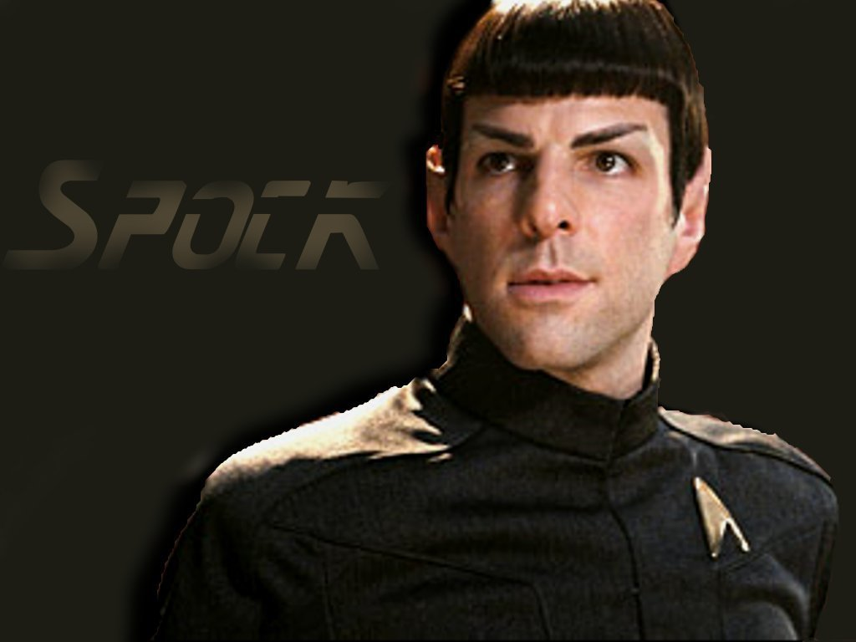
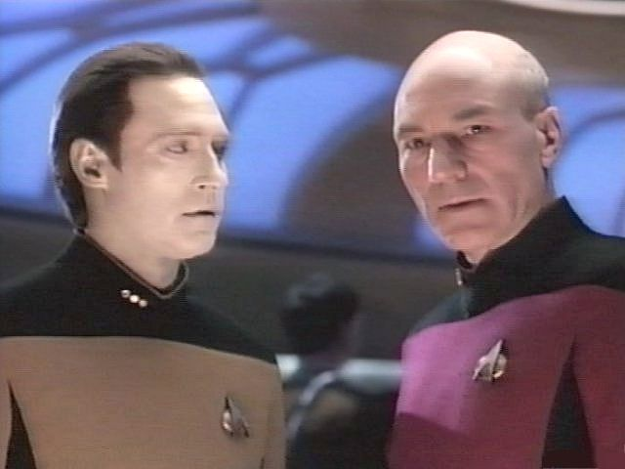
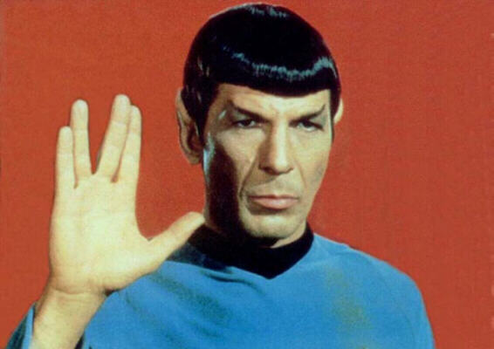
What are the Psalms?
Much more than a list of songs . . .
They really show the heart and what is “normal” for the believer in a fallen world.
Will
Intellect
Emotions
Emotions

Slide 18
Psalm 1
More than the first psalm . . .
INTRODUCTION to the entire book

Slide 19
Note 1:1
Notice the Constructive Parallelism
Sit
Stand
Walk

Slide 20
What’s the problem?
Blessed . . . who does not walk in the counsel . . .
Don’t get your values from the people who don't know or love God .
.

Slide 21
What’s the alternative?
But his delight is in the Law of the Lord and in his law he meditates day and night
And he will be like a tree

Slide 22
What’s the solution?
The fuel for a deeply personal and meaningful relationship with God (as demonstrated in Psalms 2-150) is a daily memory and meditation of the thoughts of God (Period).

Slide 25
Messiah in the Psalms
If you want to know what Jesus said while on the cross
then look in the gospels.
If you want to know what Jesus was thinking while on the cross
then look in the Psalms.

Slide 26
Psalm 110
The most “directly Messianic” of all the Psalms
Quoted extensively in the NT by:
Jesus
Peter
the author of Hebrews

Slide 27
Passover
Palm
Sun
Mon
Tue
Wed
Thu
Fri
Triumphal
Entry
Heated debate
Day of Rest in Bethany
Cross
Judas arranges to betray Jesus
Discussion of Psalm 110

Slide 28
Matthew 22:41-46
41 While the Pharisees were gathered together, Jesus asked them, 42 "What do you think about the Christ? Whose son is he?"
“The son of David," they replied.
43 He said to them, "How is it then that David, speaking by the Spirit, calls him ‘Lord’? For he says,

Slide 29
44 “The LORD (YHWH) said to ‘my Lord’ (Adonai, “my master or boss” reference to Messiah):
“Sit at my right hand
until I put your enemies
under your feet.”
45 If then David calls him ‘Lord,’ how can he be his son?"
46 No one could say a word in reply, and from that day on no one dared to ask him any more questions.

Slide 30
If David calls him "Lord"
how is he his son?
Jesse
David
Solomon
Respect
Son of David

Slide 31
Messiah is greater than David: Could he be God?!
Jesse
David
Solomon
Respect
Son of David

Slide 32
King
Priest
Psalm 110:2
2 The LORD will extend your mighty scepter from Zion;
you will rule in the midst of your enemies.
Psalm 110:4
4 The LORD has sworn and will not change his mind:
“You are a priest forever, in the order of Melchizedek."

Slide 33
Melchizedek
King&Priest
Gen 14
Moses
King Priest
Jesus
King&Priest
Psalm 110, Hebrews 5-7

Slide 34
Psalm 22
1 “My God, My God, why . . .”
6-7 insults
8 “let the Lord rescue him”
14-15 physical description of cross
16 “pierced hands feet”
18 “divide garments, cast lots”

Slide 35
Psalm 22
Was David thinking of Jesus?
Was David thinking of David?

Slide 36
Psalm 69
7-8, Jesus’ brothers
9, quoted by John about Temple
20, Jesus’ feeling on the cross
21, gall & vinegar on the cross
5, Jesus’ own sin . . .? ?! !

Slide 37
Psalm 69
Was David thinking of Jesus?
Was David thinking of David?

Slide 38
Absalom’s Revolt
The King, David
The Trusted Friend, Ahithophil
The Helper, Hushai

Slide 39
1000 yrs later...
The King, Jesus
The Trusted Friend, Judas
The Helper

Slide 40
Psalm 41:9
9 Even my close friend, whom I trusted,
he who shared my bread,
has lifted up his heel against me.
John 13:18
18 "I am not referring to all of you; I know those I have chosen. But this is to fulfill the scripture: ‘He who shares my bread has lifted up his heel against me.’
21 After he had said this, Jesus was troubled in spirit and testified, "I tell you the truth, one of you is going to betray me."

Slide 41
Psalm 69:25
25 May their place be deserted;
let there be no one to dwell in their tents.
Psalm 109:8
8 May his days be few;
may another take his place of leadership.
Acts 1:18-20
18 (With the reward he got for his wickedness, Judas bought a field; there he fell headlong, his body burst open and all his intestines spilled out.)
20 "For," said Peter, "it is written in the book of Psalms,
"May his place be deserted;
let there be no one to dwell in it,”
and, “May another take his place of leadership.”

Slide 42
Event
WB CM JR
Grace Seminary
a
a
Worked/taught for a while after graduation
a
a
a
Dallas Seminary
a
a
a
“Bible Exposition” Major
a
a
a
“Bible Arguments”
a
a
a
Cedarville College
a
a
a
Low man on totem pole ;
a
a
Taught OT Literature
a
a
Used “Bible Arguments” for class notes
a
a

Slide 43
Event
Jesus David
Kings of Israel
a
a
Born in Bethlehem
a
a
Betrayed by close associates
a
a
The betrayer commits suicide
a
a
The method of suicide is hanging
a
a
The King is eventually restored
a
a

Slide 44
A Key to Messianic Psalms
God so planned David’s life that it has many, many parallels to the life of Messiah (David’s “Son”).
Thus, by divine design (though perhaps, sometimes NOT by David’s design), many psalms refer to BOTH persons at the same time!
The Author (Holy Spirit) knows
The author (David) may not know the fullness
So, is reading through David’s deepest thoughts like reading Jesus’ thoughts?

Slide 45
Imprecatory Psalms
Psalm 109:5-13
5 They repay me evil for good,
and hatred for my friendship.
6 Appoint an evil man to oppose him;
let an accuser stand at his right hand.
7 When he is tried, let him be found guilty,
and may his prayers condemn him.
8 May his days be few;
may another take his place of leadership.
9 May his children be fatherless
and his wife a widow.
10 May his children be wandering beggars;
may they be driven from their
ruined homes.

Slide 46
11 May a creditor seize all he has;
may strangers plunder the fruits of his labor.
12 May no one extend kindness to him
or take pity on his fatherless children.
13 May his descendants be cut off,
their names blotted out from the next generation.

Slide 47
Psalm 35:4-6
4 May those who seek my life
be disgraced and put to shame;
may those who plot my ruin
be turned back in dismay.
5 May they be like chaff before the wind,
with the angel of the LORD driving them away;
6 may their path be dark and slippery,
with the angel of the LORD pursuing them.

Slide 48
Psalm 35:4-9
7 Since they hid their net for me without cause
and without cause dug a pit for me,
8 may ruin overtake them by surprise
may the net they hid entangle them,
may they fall into the pit, to their ruin.
9 Then my soul will rejoice in the LORD
and delight in his salvation.

Slide 49
Psalm 83:13-18
13 Make them like tumbleweed, O my God,
like chaff before the wind.
14 As fire consumes the forest
or a flame sets the mountains ablaze,
15 so pursue them with your tempest
and terrify them with your storm.
16 Cover their faces with shame
so that men will seek your name, O LORD.
17 May they ever be ashamed and dismayed;
may they perish in disgrace.
18 Let them know that you, whose name is the LORD
that you alone are the Most High over all the earth.

Slide 50
Psalm 137:1-9
1 By the rivers of Babylon we sat and wept
when we remembered Zion.
2 There on the poplars
we hung our harps,
3 for there our captors asked us for songs,
our tormentors demanded songs of joy;
they said, Sing us one of the songs of Zion!"
4 How can we sing the songs of the LORD
while in a foreign land?
5 If I forget you, O Jerusalem,
may my right hand forget its skill.
6 May my tongue cling to the roof of my mouth
if I do not remember you,
if I do not consider Jerusalem
my highest joy.
7 Remember, O LORD, what the Edomites did
on the day Jerusalem fell.
Tear it down," they cried,
tear it down to its foundations!
8 O Daughter of Babylon, doomed to destruction,
happy is he who repays you
for what you have done to us
9 he who seizes your infants
and dashes them against the rocks.

Slide 51
Potential Views: What do you think of...
“An evidence of the low spiritual climate of the Old Testament”
“These are simply the writer’s feelings”
“They’re predictions, not requests”

Slide 52
My understanding
Requests for God and God’s people to be vindicated before the world and for God to execute righteous judgment.

Slide 53
Psalm 58:6-11
6 Break the teeth in their mouths, O God;
tear out, O LORD, the fangs of the lions!
7 Let them vanish like water that flows away;
when they draw the bow, let their arrows be blunted.
8 Like a slug melting away as it moves along,
like a stillborn child, may they not see the sun.
9 Before your pots can feel the heat of the thorns
whether they be green or dry the wicked will be swept
away.
10 The righteous will be glad when they are avenged,
when they bathe their feet in the blood of the wicked.
11 Then men will say,
“Surely the righteous still are rewarded;
surely there is a God who judges the earth."

Slide 54
Selah . . .

