Slide 1
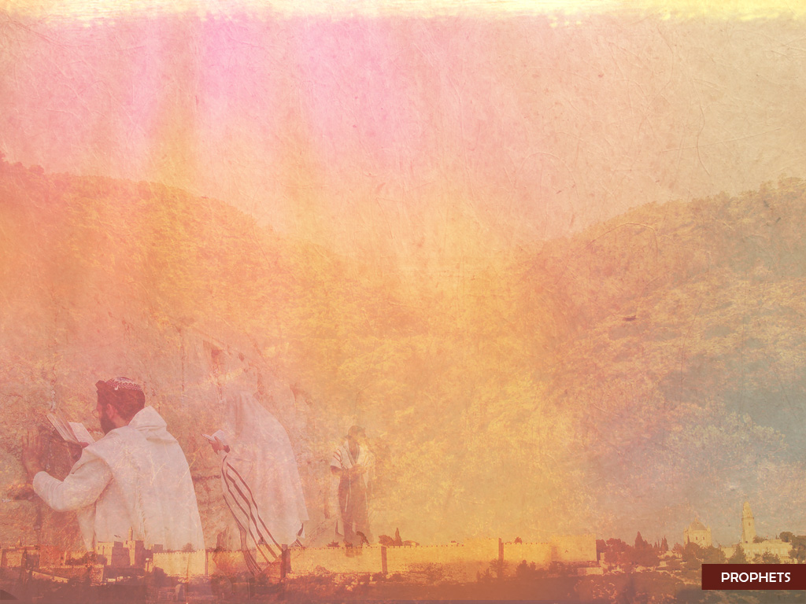
Review of Hosea
Get the theology
  Bad news, Good news
  Divorce, Remarriage
Don’t miss the heart
  All of Jesus’ references to brides and bridegrooms are more meaningful than most people realize.

Slide 2
THE DESTRUCTION OF SENNACHERIB, first published in 1815
The Assyrian came down like the wolf on the fold,
And his cohorts were gleaming in purple and gold;
And the sheen of their spears was like stars on the sea,
When the blue wave rolls nightly on deep Galilee.
Like the leaves of the forest when Summer is green,
That host with their banners at sunset were seen:
Like the leaves of the forest when Autumn hath blown,
That host on the morrow lay withered and strown.
For the Angel of Death spread his wings on the blast,
And breathed in the face of the foe as he passed;
And the eyes of the sleepers waxed deadly and chill,
And their hearts but once heaved, and for ever grew still!
And there lay the steed with his nostril all wide,
But through it there rolled not the breath of his pride;
And the foam of his gasping lay white on the turf,
And cold as the spray of the rock-beating surf.
And there lay the rider distorted and pale,
With the dew on his brow, and the rust on his mail:
And the tents were all silent, the banners alone,
The lances unlifted, the trumpet unblown.
And the widows of Ashur are loud in their wail,
And the idols are broke in the temple of Baal;
And the might of the Gentile, unsmote by the sword,
Hath melted like snow in the glance of the Lord!

Slide 3
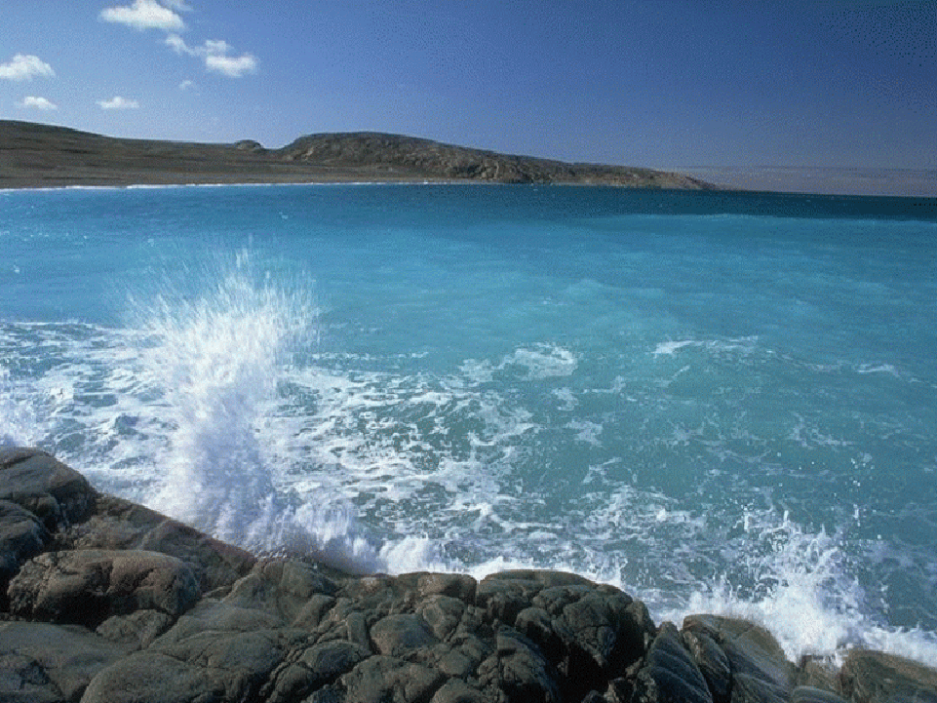
Isaiah
MISSION
Israel
Notes:
Mission=primary aim and goals… starbucks,
God’s Know him, join his project to reclaim his hi-jacked kingdom

Slide 4
2 Historical Centers
History
History
7-12
36-39
1-6
13-35
40-66
Sermons, Prophecy
Yosemite

Slide 5
2 Historical Centers
Ahaz
Hezekiah
7-12
36-39
1-6
13-35
40-66
Assyrian aggression
Crisis:
Jerusalem water source
Place:
Issue:
Who will rescue us?

Slide 6
2 Historical Centers
Failure
Failure
7-12
36-39
1-6
13-35
40-66
Intro &
Overview
Solution
Solution

Slide 7
1A Introduction, 1-6
1B The Rebellion of the People Stated, 1
Isaiah 1:18-20
18 “Come now, let us reason together," says the LORD.
“Though your sins are like scarlet,
they shall be as white as snow;
though they are red as crimson,
they shall be like wool.
19 If you are willing and obedient, you will eat the best from the land;
20 but if you resist and rebel, you will be devoured by the sword." For the mouth of the LORD has spoken.

Slide 8
1A Introduction, 1-6
1B The Rebellion of the People Stated, 1
2B The Rebellion Illustrated, 2-5
Isaiah 5:1-2 I will sing for the one I love
a song about his vineyard:
My loved one had a vineyard
on a fertile hillside.
2 He dug it up and cleared it of stones
and planted it with the choicest vines.
He built a watchtower in it
and cut out a winepress as well.
Then he looked for a crop of good grapes,
but it yielded only bad fruit.

Slide 9
1A Introduction, 1-6
1B The Rebellion of the People Stated, 1
2B The Rebellion Illustrated, 2-5
Isaiah 5:3-4
3 “Now you dwellers in Jerusalem and men of Judah,
judge between me and my vineyard.
4 What more could have been done for my vineyard
than I have done for it?
When I looked for good grapes,
why did it yield only bad?

Slide 10
1A Introduction, 1-6
1B The Rebellion of the People Stated, 1
2B The Rebellion Illustrated, 2-5
Isaiah 5:5
5 Now I will tell you
what I am going to do to my vineyard:
I will take away its hedge,
and it will be destroyed;
I will break down its wall,
and it will be trampled.
John 15:1
1 "I am the true vine, and my Father is the gardener.

Slide 11
1A Introduction, 1-6
3B The Solution: The example of Isaiah's Call, 6
Isaiah 6:1-3
1 In the year that King Uzziah died, I saw the Lord seated on a throne, high and exalted, and the train of his robe filled the temple. 2 Above him were seraphs, each with six wings: With two wings they covered their faces, with two they covered their feet, and with two they were flying. 3 And they were calling to one another:
“Holy, holy, holy is the LORD Almighty;
the whole earth is full of his glory."

Slide 12
1A Introduction, 1-6
3B The Solution: The example of Isaiah's Call, 6
Isaiah 6:5-7
5 "Woe to me!" I cried. "I am ruined! For I am a man of unclean lips, and I live among a people of unclean lips, and my eyes have seen the King, the LORD Almighty."
6 Then one of the seraphs flew to me with a live coal in his hand, which he had taken with tongs from the altar. 7 With it he touched my mouth and said, "See, this has touched your lips; your guilt is taken away and your sin atoned for."
Isaiah
Trusts

Slide 13
1A Introduction, 1-6
3B The Solution: The example of Isaiah's Call, 6
Isaiah
Tells
Isaiah 6:8
8 Then I heard the voice of the Lord saying, “Whom shall I send? And who will go for us?”
And I said,
“Here am I. Send me!”

Slide 14
2A Trust in Yahweh, the basis of servanthood, 7-12
Isaiah 7:1
1 When Ahaz son of Jotham, the son of Uzziah, was king of Judah, King Rezin of Aram and Pekah son of Remaliah king of Israel marched up to fight against Jerusalem, but they could not overpower it.

Slide 15
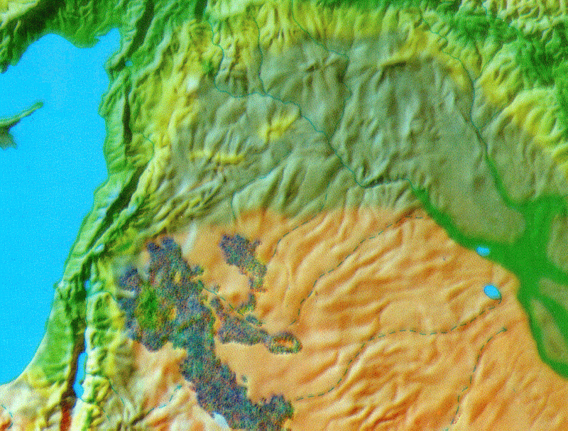
Assyria
Syria, King Rezin
Israel, King Pekah
Judah, King Ahaz

Slide 16


Assyria
Assyria
Syria
Syria
Israel
Israel
Judah
Judah

Slide 17
Ahaz's Crisis
Isaiah 7:2-3 Now the house of David was told, "Aram (Syria) has allied itself with Ephraim (Israel)"; so the hearts of Ahaz (King of Judah) and his people were shaken, as the trees of the forest are shaken by the wind.
3 Then the LORD said to Isaiah, "Go out, you and your son, to meet Ahaz at the end of the aqueduct of the Upper Pool, on the road to the Washerman's Field (Gihon Spring).

Slide 18
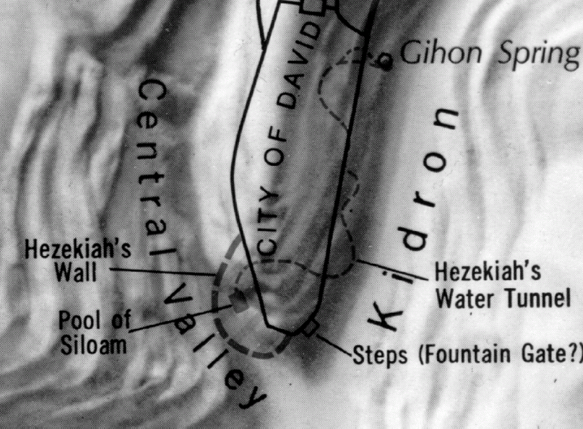

Slide 20
Isaiah 7:4-7 and say to him, 'Take care, and be calm, have no fear and do not be fainthearted because of these two stubs of smoldering firebrands, on account of the fierce anger of Rezin and Aram, and the son of Remaliah (Pekah).
5 'Because they have planned evil against you, saying, 6 "Let us go up against Judah (2 southern tribes) and terrorize it, and make for ourselves a breach in its walls, ..."
7 thus says the LORD GOD, "It shall not stand nor shall it come to pass.”

Slide 21
Assyria
Assyria
Syria
Syria
Israel
Israel
Judah
Judah

Slide 22
Assyria
Assyria
Assyria
Assyria
Judah
Judah

Slide 23
2B The Answer: God is to be trusted, 13:1--35:10
1C God is Sovereign...demonstrated by His judgment
Failure
7-12
13-35
Trust
Do you really want to put your trust in other nations?
Here is how they'll come to an end!
Notes:
What makes you secure?
What are you afraid to lose most?

Slide 24
2B The Answer: God is to be trusted, 13:1--35:10
1C God is Sovereign...demonstrated by His judgment
4C Summary
1D The folly of trust in the nations, 34
The Desert / Armegeddon
1 Come near, you nations, and listen;
pay attention, you peoples!
Let the earth hear, and all that is in it,
the world, and all that comes out of it!
2 The LORD is angry with all nations;
his wrath is upon all their armies.
He will totally destroy them,
he will give them over to slaughter.

Slide 25
2B The Answer: God is to be trusted, 13:1--35:10
1C God is Sovereign...demonstrated by His judgment
4C Summary
1D The folly of trust in the nations, 34
The Desert / Armegeddon
3 Their slain will be thrown out,
their dead bodies will send up a stench;
the mountains will be soaked with their blood.
4 All the stars of the heavens will be dissolved
and the sky rolled up like a scroll;
all the starry host will fall
like withered leaves from the vine,
like shriveled figs from the fig tree.

Slide 26
2B The Answer: God is to be trusted, 13:1--35:10
1C God is Sovereign...demonstrated by His judgment
4C Summary
1D The folly of trust in the nations, 34
2D The wisdom of trust in Yahweh, 35
The Garden / Kingdom
1 The desert and the parched land will be glad;
the wilderness will rejoice and blossom.
Like the crocus,
2 it will burst into bloom;
it will rejoice greatly and shout for joy.
The glory of Lebanon will be given to it,
the splendor of Carmel and Sharon;
they will see the glory of the LORD,
the splendor of our God.

Slide 27
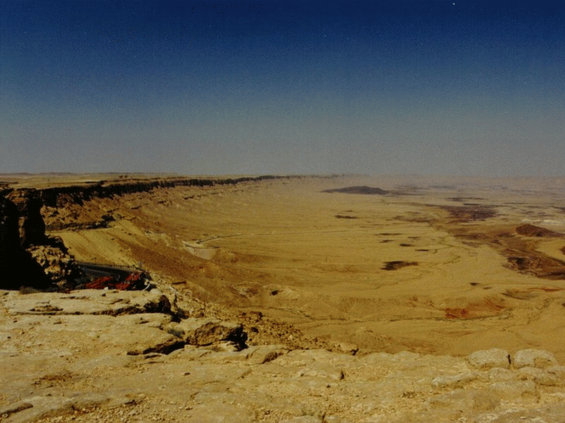
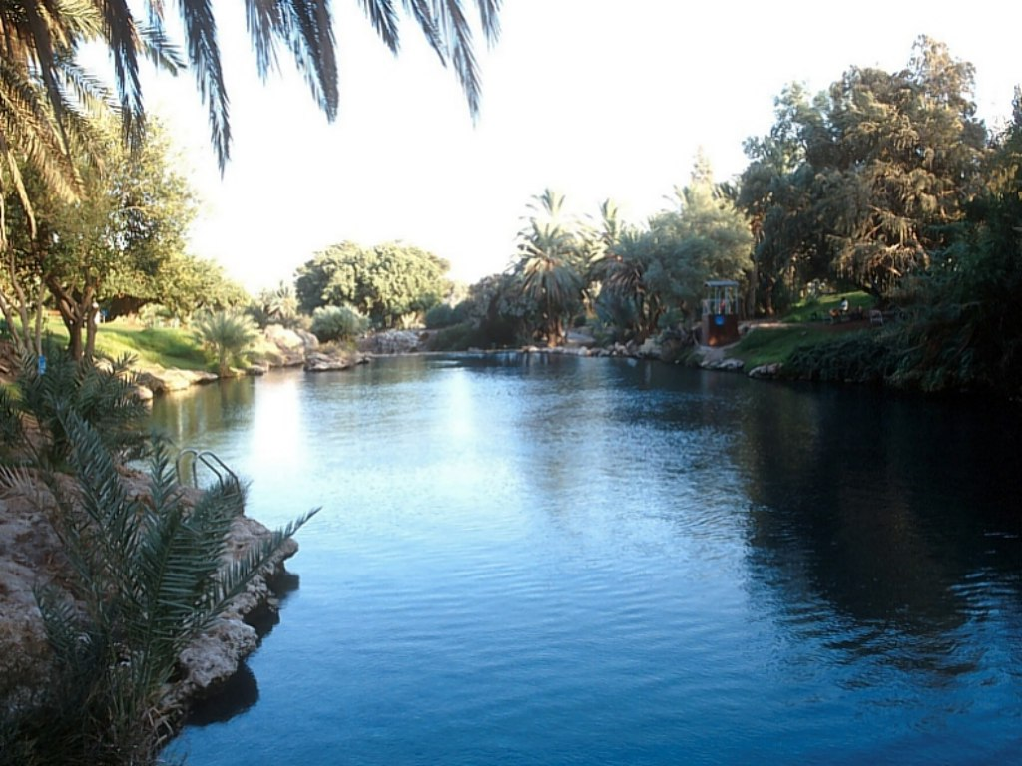
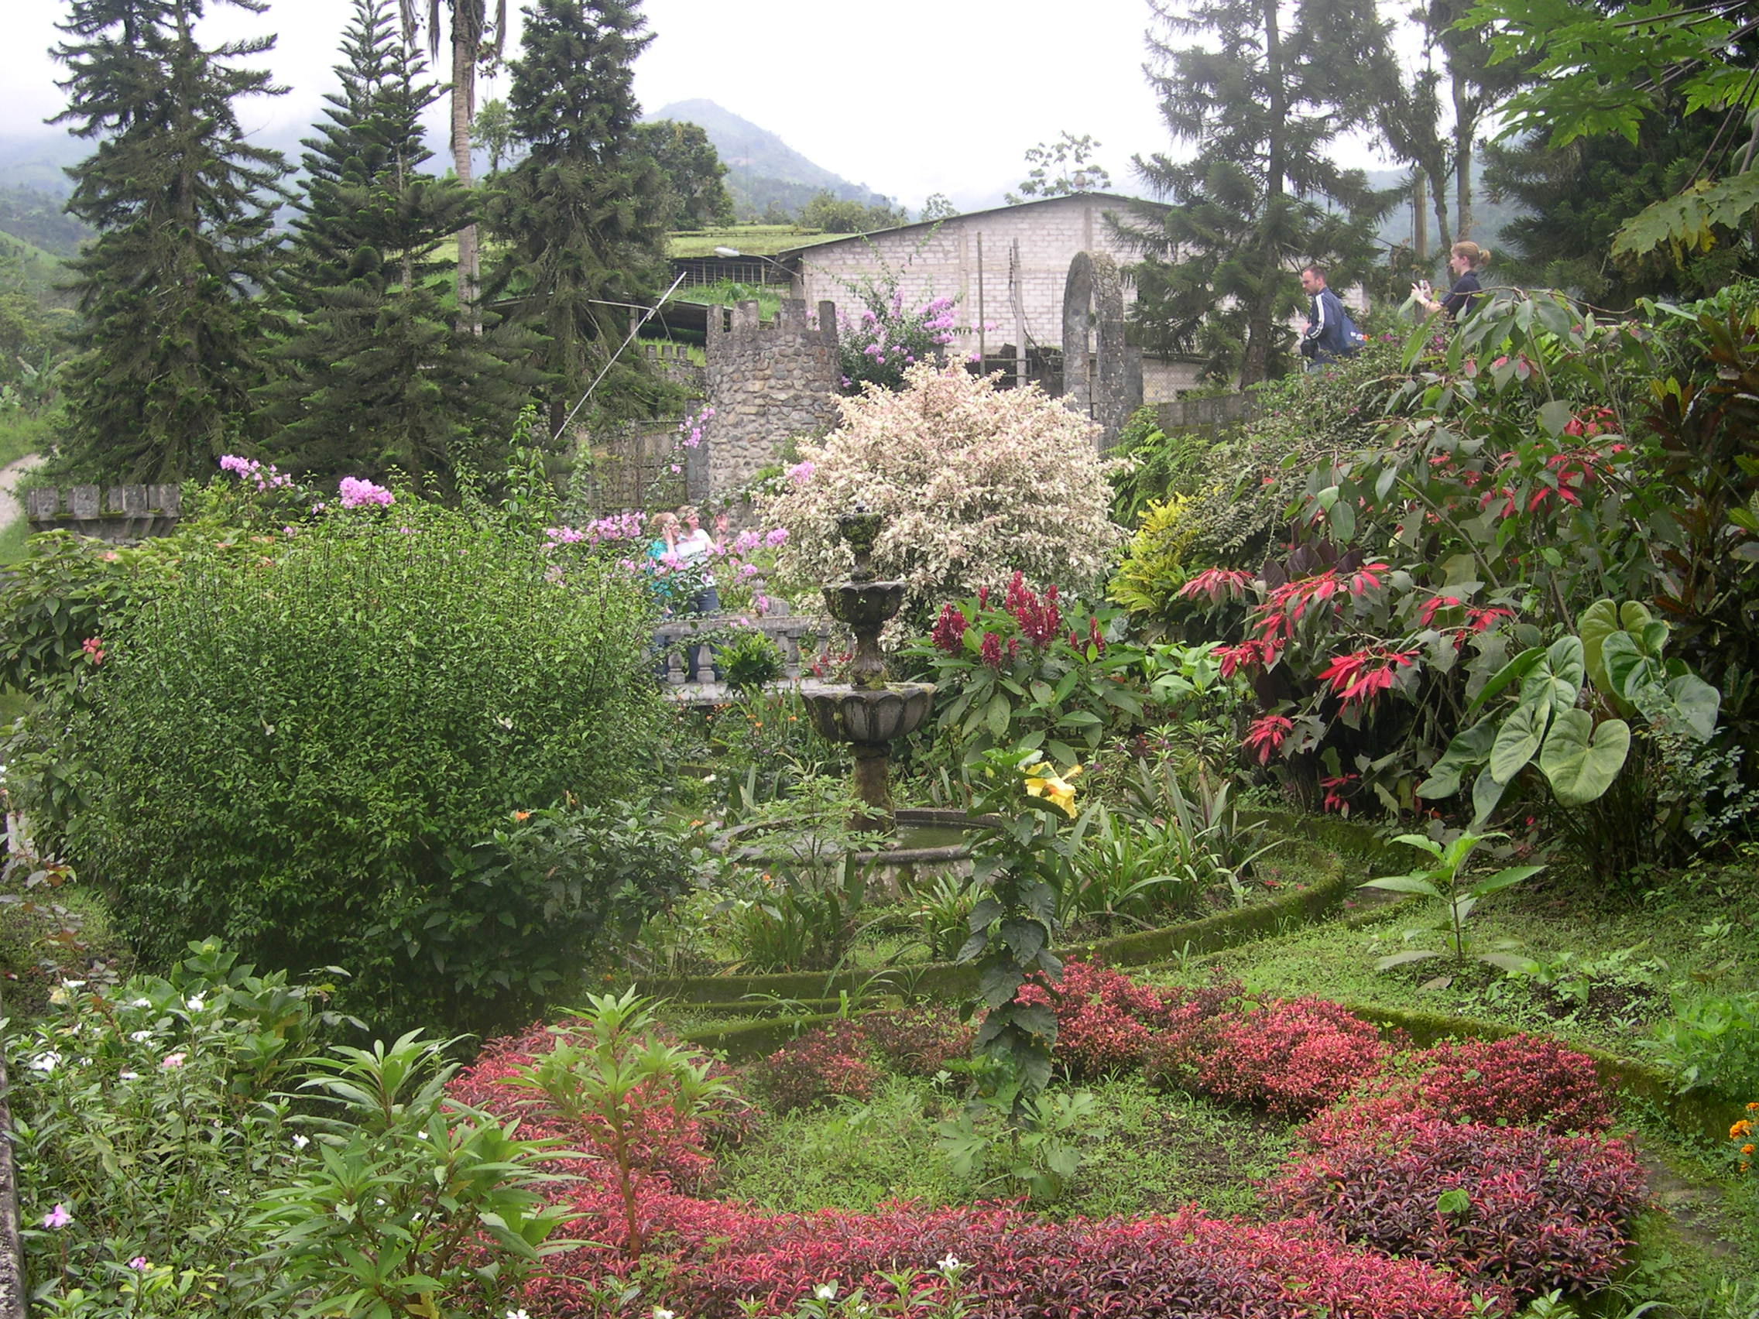
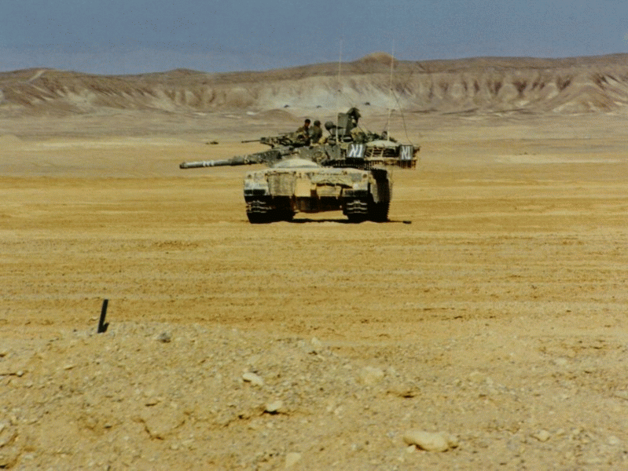

Slide 28
Isaiah 35:5-7
5 Then will the eyes of the blind be opened
and the ears of the deaf unstopped.
6 Then will the lame leap like a deer,
and the mute tongue shout for joy.
Water will gush forth in the wilderness
and streams in the desert.
7 The burning sand will become a pool,
the thirsty ground bubbling springs.
In the haunts where jackals once lay,
grass and reeds and papyrus will grow.

Slide 29
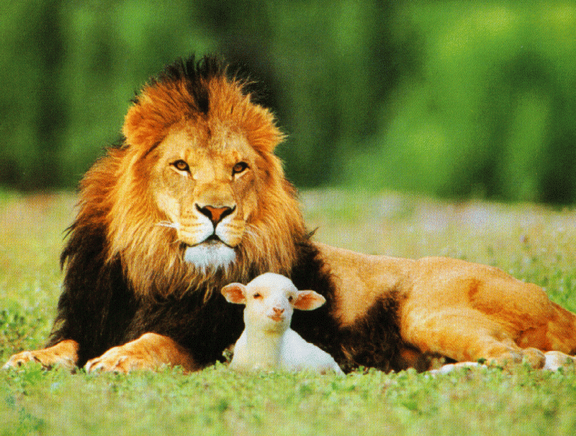
Isaiah 11:6-8
6 The wolf will live with the lamb,
the leopard will lie down with the goat,
the calf and the lion and the yearling together;
and a little child will lead them.
7 The cow will feed with the bear,
their young will lie down together,
and the lion will eat straw like the ox.
8 The infant will play near the hole of the cobra,
and the young child put his hand into the viper’s nest.

Slide 30
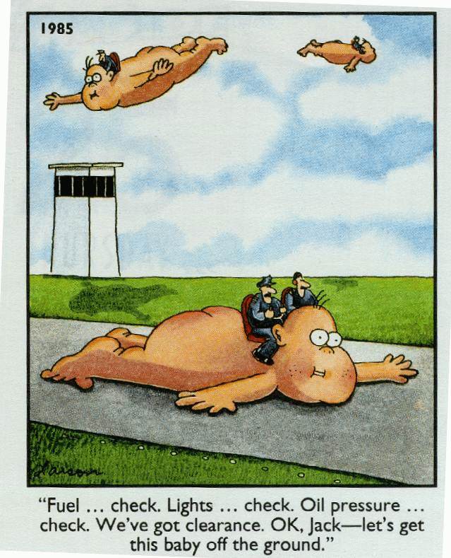
Half-
time!

Slide 31
2 Historical Centers
Failure
Failure
7-12
36-39
1-6
13-35
40-66
Trust
Solution

Slide 32
3A The Glory of Yahweh: The Goal of Servanthood, 36-66
1B Historical Introduction, 36-39
Isaiah 36:1-2
1 In the fourteenth year of King Hezekiah's reign, Sennacherib king of Assyria attacked all the fortified cities of Judah and captured them. 2 Then the king of Assyria sent his field commander with a large army from Lachish to King Hezekiah at Jerusalem. When the commander stopped at the aqueduct of the Upper Pool, on the road to the Washerman's Field,

Slide 33
Assyria
Sennacherib
701 B.C.
46 down
1 big one to go
Judah

Slide 34
Isaiah 37:1-2
1 When King Hezekiah heard this, he tore his clothes and put on sackcloth and went into the temple of the LORD. 2 He sent Eliakim the palace administrator, Shebna the secretary, and the leading priests, all wearing sackcloth, to the prophet Isaiah.
Isaiah 37:20
20 Now, O LORD our God, deliver us from his hand, so that all kingdoms on earth may know that you alone, O LORD, are God."

Slide 35
Isaiah 37:36-37
36 Then the angel of the LORD went forth, and smote in the camp of the Assyrians a hundred and fourscore and five thousand: and when they arose early in the morning, behold, they were all dead corpses. 37 So Sennacherib king of Assyria departed, and went and returned, and dwelt at Nineveh.

Slide 36
Isaiah 37:38
38 One day, while he was worshiping in the temple of his god Nisroch, his sons Adrammelech and Sharezer cut him down with the sword, and they escaped to the land of Ararat. And Esarhaddon his son succeeded him as king.
Temple

Slide 37
Isaiah 38:1
In those days was Hezekiah sick unto death. And Isaiah the prophet came and said unto him, Thus saith the LORD, Set thine house in order: for thou shalt die, and not live.
Isaiah 38:4-5
4 Then the word of the LORD came to Isaiah: 5 "This is what the LORD, the God of your father David, says: I have heard your prayer and seen your tears; I will add fifteen years to your life.

Slide 38
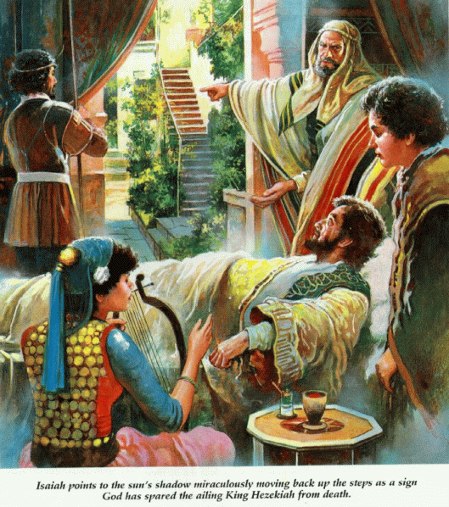
Isaiah 38:7-8
7 “This is the LORD's sign to you that the LORD will do what he has promised: 8 I will make the shadow cast by the sun go back the ten steps it has gone down on the stairway of Ahaz.'" So the sunlight went back the ten steps it had gone down.

Slide 39
Isaiah 39:1-4
1 At that time Merodach-Baladan king of Babylon sent Hezekiah letters and a gift, because he had heard of his illness and recovery. 2 Hezekiah received the envoys gladly and showed them what was in his storehouses: the silver, the gold, the spices, the fine oil, his entire armory and everything found among his treasures. There was nothing in his palace or in all his kingdom that Hezekiah did not show them.
4 The prophet asked, "What did they see in your palace?"
“They saw everything in my palace," Hezekiah said. "There is nothing among my treasures that I did not show them."

Slide 40
Gold?
God?

Slide 41
2 Chronicles 32:31, 25
But when the envoys were sent by the rulers of Babylon to ask him about the miraculous sign that had occurred in the land, God left him to test him and to know everything that was in his heart, But Hezekiah’s heart was proud and he gave no return to the kindness shown to him...

Slide 42
2 Measures of Servanthood
Ahaz
Hezekiah
Trust God?
Tell about God?

Slide 43
2 Historical Centers
Failure
Failure
7-12
36-39
1-6
13-35
40-66
Trust
Tell

Slide 44
3A The Glory of Yahweh: The Goal of Servanthood, 36-66
1B Historical Introduction, 36-39
2B The Glory of God seen… 40--66
Isaiah 40:3-5
3 A voice of one calling:
“In the desert prepare
the way for the LORD;
make straight in the wilderness
a highway for our God.
4 Every valley shall be raised up,
every mountain and hill made low;
the rough ground shall become level,
the rugged places a plain.
5 And the glory of the LORD will be revealed,
and all mankind together will see it. For the mouth of the
LORD has spoken."

Slide 45
Isaiah 42:8
8 "I am the LORD; that is my name!
I will not give my glory to another
or my praise to idols.
Isaiah 44:23
23 Burst into song, you mountains,
you forests and all your trees,
for the LORD has redeemed Jacob,
he displays his glory in Israel.
Isaiah 48:11
11 For my own sake, for my own sake, I do this.
How can I let myself be defamed?
I will not yield my glory to another.

Slide 46
Isaiah 66:18-19
18 "And I, because of their actions and their imaginations, am about to come and gather all nations and tongues, and they will come and see my glory.
19 "I will set a sign among them, and I will send some of those who survive to the nationsCto Tarshish, to the Libyans and Greece, and to the distant islands that have not heard of my fame or seen my glory. They will proclaim my glory among the nations.

Slide 47
Servant Songs
Chapters: 42, 49, 50, 52-53
Descriptions of Messiah, the ultimate Servant, who trusts and tells.

Slide 48
Isaiah 52:13-15
13 See, my servant will act wisely;
he will be raised and lifted up and highly exalted.
14 Just as there were many who were appalled at him
his appearance was so disfigured beyond that of any man
and his form marred beyond human likeness
15 so will he sprinkle many nations,

Slide 49
Isaiah 53:2
2 He grew up before him like a tender shoot,
and like a root out of dry ground.
He had no beauty or majesty to attract us to him,
nothing in his appearance that we should desire him.
Isaiah 53:5
5 But he was pierced for our transgressions,
he was crushed for our iniquities;
the punishment that brought us peace was upon him,
and by his wounds we are healed.
Isaiah 53:6
6 We all, like sheep, have gone astray,
each of us has turned to his own way;
and the LORD has laid on him
the iniquity of us all.

Slide 50
Isaiah 53:7
7 He was oppressed and afflicted,
yet he did not open his mouth;
he was led like a lamb to the slaughter,
and as a sheep before her shearers is silent,
so he did not open his mouth.
Isaiah 53:9
9 He was assigned a grave with the wicked,
and with the rich in his death,
though he had done no violence,
nor was any deceit in his mouth.

Slide 51
Isaiah
Ahaz
Selah
Hezekiah
Servant
Messiah
Israel
Me ?

Slide 52
THE DESTRUCTION OF SENNACHERIB, first published in 1815
The Assyrian came down like the wolf on the fold,
And his cohorts were gleaming in purple and gold;
And the sheen of their spears was like stars on the sea,
When the blue wave rolls nightly on deep Galilee.
Like the leaves of the forest when Summer is green,
That host with their banners at sunset were seen:
Like the leaves of the forest when Autumn hath blown,
That host on the morrow lay withered and strown.
For the Angel of Death spread his wings on the blast,
And breathed in the face of the foe as he passed;
And the eyes of the sleepers waxed deadly and chill,
And their hearts but once heaved, and for ever grew still!
And there lay the steed with his nostril all wide,
But through it there rolled not the breath of his pride;
And the foam of his gasping lay white on the turf,
And cold as the spray of the rock-beating surf.
And there lay the rider distorted and pale,
With the dew on his brow, and the rust on his mail:
And the tents were all silent, the banners alone,
The lances unlifted, the trumpet unblown.
And the widows of Ashur are loud in their wail,
And the idols are broke in the temple of Baal;
And the might of the Gentile, unsmote by the sword,
Hath melted like snow in the glance of the Lord!

