Slide 1
1-2
Samuel
Simply the history of David?

Slide 2
Why use Narrative?
It draws the reader into the story allowing us to “see” and “feel” truth.
It illustrates propositional truths,
e.g., “Do not murder” “Do not commit adultery”

Slide 3
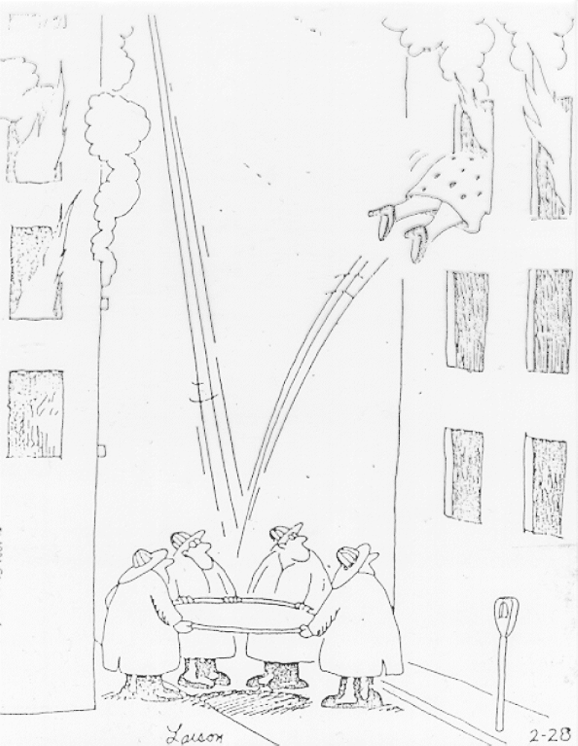

Slide 4
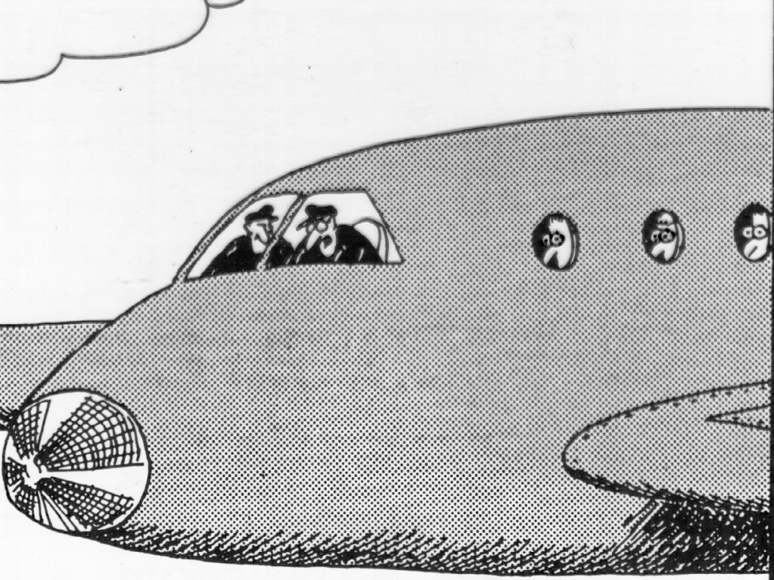
“The fuel light’s on, Frank! We’re all going to die! . . . We’re all going to die! . .. Wait, wait . . . Oh, my mistake—that’s the intercom light."

Slide 5
Proposition
Caption
Picture
Story

Slide 6
Gen 3:15
Cain & Abel

Slide 7
Gen 12
Sarah in Egypt
Sacrifice of Isaac
Exodus, Balaam, Joshua
Coming of Jesus

Slide 8
What does Narrative illustrate?
Are we left to our own to find out?
Does each story have a “moral" of its own?
Is 1-2 Samuel just a collection of miscellaneous “good" stories?
LO !
NOT !

Slide 9
What does Narrative illustrate?
All Biblical narratives are well- written and very selective literary pieces which point to a singular theme.
That theme or propositional truth is always stated within the book . . . and usually early in the book.

Slide 10
What is the proposition & thus, point of Samuel?
Where do we find statements of truth early in the book?
The words of Hannah provide the theme which the rest of the book merely illustrates

Slide 11
Hannah’s speech
Stories of David

Slide 12
Hannah’s Prayer
2:7 The Lord sends poverty and wealth
He humbles and he exalts
He raises the poor from the dust
2:9 It is NOT by strength that one prevails
2:10 those who oppose the Lord will be shattered

Slide 13
This truth gives unity to the whole book
1A God Prospers Faithful Hannah
2A God Hinders Unfaithful Israel
3A God Prospers Faithful Saul
4A God Hinders Saul / Prospers David
5A God Prospers Faithful David
6A God Hinders Unfaithful David

Slide 14
David’s Life
Covers sin 10-12
Throne established 7
Amnon dies 13
Place of Worship 6
Absalom 14-19
Nation United 3-5
More rebellion 20
Strength Increases 2-3

Slide 15
Davidic Covenant
If David isn't the seed,
then is it his son?
2 Sam 7:11-16

Slide 16
Background:
In 2 Samuel God blesses David so that he can unite the country and establish his capital at Jerusalem.
After David builds his palace and moves the tabernacle to Jerusalem he begins to contemplate what he can do to further honor God.
Hmmmm…. I’m living in this nice permanent house and God is living in a mobile home…. Hmmm… “I’d like to build you a permanent house (Temple) God.”

Slide 17
7:11 The Lord tells you that he will make you a house
David will have a Dynasty
7:12 I will set up your seed after you, who will come from your body
The promise concerns one of David’s physical descendants
He shall build a house for me
This son will build a Temple
I will establish his throne forever
This son will never lose the throne

Slide 18
Who is the Son?
Solomon
Physical descendant
Built temple
Reigned on throne . . .
But NOT Forever
Zerubbabel
Physical descendant
Built temple
But didn’t reign on a throne
Jesus
Physical descendant
Build temple?
Reign on throne forever
2.5
2.0
3.0

Slide 19
2 Sam 7
49
12
3:15

Slide 20
and between thy seed and her seed;
Cain
Abel
Seed
Seed
Lamech
Enoch
Canaan
Shem
Abraham
Judah
David

Slide 21
He shall crush thy head, you will bruise his heel
Satan
Seed
Noah
Joseph
Isaac
David !
Solomon
Zerubbabel

