Slide 1
Micah, Nahum, Zephaniah
God the King,
Protector &
Preserver of Truth

Slide 2
Preview for M, N, Z
Why the world dreams about the leadership that only Jesus can give.
What it means to really trust God when other people treat you badly.
Why also can be such a wicked word.

Slide 3
Where we are in history
Nahum
Zephaniah
Israel
Isaiah
Micah
Judah
722
586

Slide 4
The theme of Micah
It’s all about failed kings and especially of the hope of a King who won’t . . .

Slide 5
The effect of Messiah on the world
Micah 4:2,3 Many nations will come and say, “Come, let us go up to the mountain of the LORD, to the house of the God of Jacob. He will teach us his ways, so that we may walk in his paths.”
The law will go out from Zion, the word of the LORD from Jerusalem.
3 He will judge between many peoples and will settle disputes for strong nations far and wide.
They will beat their swords into plowshares and their spears into pruning hooks. Nation will not take up sword against nation, nor will they train for war anymore.

Slide 6
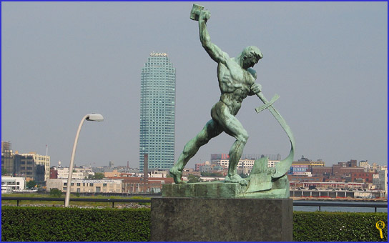
Beating swords into plowshares at the United Nations building in NYC

Slide 7
The effect of Messiah on ISRAEL
Micah 5:2-4 "But you, Bethlehem Ephrathah, though you are small among the clans of Judah, out of you will come for me one who will be ruler over Israel, whose origins are from of old, from ancient times."
Therefore Israel will be abandoned
until the time when she who is in labor gives birth and the rest of his brothers return to join the Israelites.
4 He will stand and shepherd his flock in the strength of the LORD, in the majesty of the name of the LORD his God. And they will live securely, for then his greatness will reach to the ends of the earth.

Slide 8
4
3
2
Millennium
&
Ultimate
Restoration
1
Christ's
First
Coming
Captivity
and
Restoration
Prophet's own time
Micah 5:2-4 "But you, Bethlehem Ephrathah, though you are small among the clans of Judah, out of you will come for me one who will be ruler over Israel, whose origins are from of old, from ancient times."
Therefore Israel will be abandoned
until the time when she who is in labor gives birth and the rest of his brothers return to join the Israelites.
4 He will stand and shepherd his flock in the strength of the LORD, in the majesty of the name of the LORD his God. And they will live securely, for then his greatness will reach to the ends of the earth.
2
3
4
586
4BC
2nd Coming

Slide 9
Where
Micah 5:2-4
}
David
2 Sam 7
Judah
49
Who
Abraham
12
Eve
3:15

Slide 10
How's your scripture memory?
Micah 7:20 You will be true to Jacob, and show mercy to Abraham, as you pledged on oath to our fathers in days long ago.
Luke 1:54-55 He has helped his servant Israel, remembering to be merciful to Abraham and his descendants forever, even as he said to our fathers."
Micah 5:2-4
2 Sam 7
49
12
3:15

Slide 11
Nahum
Multiple Choice: According to Nahum, My God is:
A
B
C
D
E
Holy
Glorious
Sarcastic
Vengeful
Two of the above

Slide 12
Nahum vs. Jonah
Who went to Nineveh?
Who preached to Ninevites?
Who preached salvation?
Who preached destruction?
Who wrote his letter to comfort Israel?

Slide 13
Survey
1A God's character as Avenger 1:1-8
  2B His character, 1:2-3a
2A God's character shown in vengeance on Assyria, 1:9-22
  1B Declaration #1, 1:9-13
    1C The Completeness of her end
  2B Declaration #2, 1:14-15
    1C The Permanence of her end
  3B Declaration #3, 2:1-2
    1C The Imminence of her end

Slide 14
3A God's character shown again
  1B Description of the Siege and Defeat, 2:3-9
  Very graphic & detailed account of the battle
  3B Description of the city’s defeat, 2:13—3:7
  Even more graphic!
  4B The Hopelessness of the City
    1C Comparison to Thebes
    2C Sarcastic Address to Prepare for the Enemy, 3:14-17
    “Oh sure, go ahead and try to defend yourselves. A lot of good that will do!”
    3C Specific address to the King, 3:18-19
    “6th century trash talk”

Slide 15
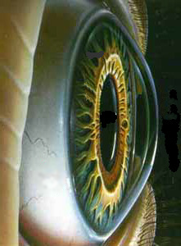
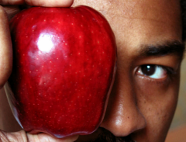
What's the Point?
Zechariah 2:8-9 For this is what the LORD Almighty says: "After he has sent me against the nations that have plundered you --for whoever touches you touches the apple of his eye -- 9 I will surely raise my hand against them so that their slaves will plunder them. Then you will know that the LORD Almighty has sent me.

Slide 16
This is why the NT teaching about revenge works
Romans 12:14-21 . . .
Vs. 19 “Do not take revenge, my friends, but leave room for God’s wrath, for it is written: ‘It is mine to avenge; I will repay’”
When I take my own vengeance I’m saying
“I don’t trust you God to do your job”
“I want to be in control of this situation”
I will know I have trusted God to avenge me when I want good for the other person.

Slide 17
Zephaniah: When you find yourself sinking to the level of the crowd
God doesn't grade
on a curve

Slide 18
Note the directions
1A Universal Judgment
3B Oracles Against All Nations
1C Against Judah
2C Against nations to the West: Philistia
3C Against nations to the East: Moab and Ammon
4C Against nations to the South: Ethiopia
5C Against nations to the North: Assyria
6C Against Jerusalem

Slide 19
Which is most objectionable?
Zephaniah 1:4, 5 I will stretch out my hand against . . . those who bow down on the roofs to worship the starry host, those who bow down and swear by the LORD and who also swear by Molech,

Slide 20
The task
Syncretism is the mixing of truth & error.
Integration is the careful collection of truth, while separating it from error.

Slide 21
Theology
Education
Psychology
Truth
Error

Slide 22
Work, Family
Church Member
Dating
Truth
Error

Slide 23
Work, Family
Church Member
Dating
Syncretism
Worship God AND Molech

Slide 24
Travel
safely!

