Slide 1
Daniel, Ezekiel & Eschatology
Daniel, the Statesman
Ezekiel, the Prophet &
Eschatology, the study of things to come.
“Candellight” Hannukah by the Maccabeats

Slide 2
A linear look at progress
1975
1995
2015

Slide 3
The only time the Church is in the middle is when the pendulum is swinging from side to side.
Fever pitch
Apathy
1975
2015

Slide 4
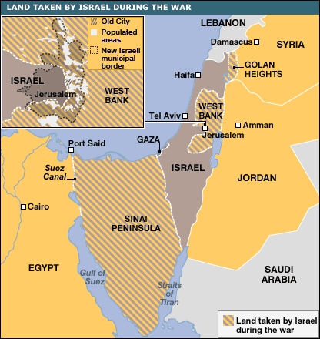
The only time the Church is in the middle is when the pendulum is swinging from side to side.
70
135
1948
1967
1988
2015
Jerusalem
destroyed
Bar Kochba
Jews exiled
for good
Jews allowed
back into the land
Israel becomes a
nation again
The miracle
six-day war
embarrassment

Slide 5
The only time the Church is in the middle is when the pendulum is swinging from side to side.
Fever pitch
Apathy
1975
2015

Slide 6
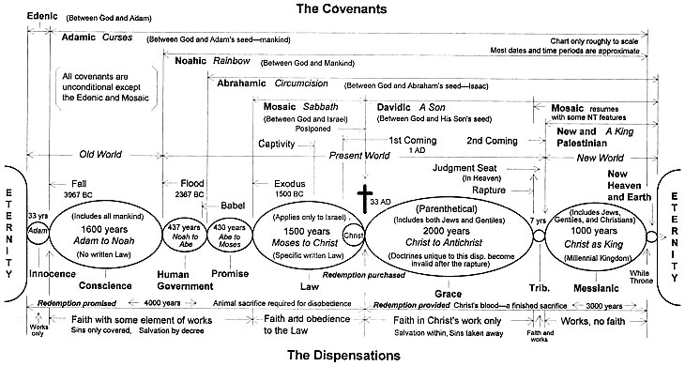
Eschatology: What’s it good for?
Making very cool & complex charts
Making cheesy movies
Encouraging believers that God will finally reclaim this hi-jacked world when it appears that he has walked off the job.

Slide 7
Chap. 2
Chap. 7
Chap. 8
626
The future is merely
history to God
and His promises
will become reality,
in due time.
600
Head
of
Gold
BABYLONIA
LION
BABYLON
2:48
539
500
MEDO-PERSIA
Chest &
Arms of
Silver
MEDO-
PERSIA
8:20
400
BEAR
RAM
330
300
GREECE
Belly &
Thighs of
Bronze
GOAT
GREECE
8:21
LEOPARD
200
167 B.C.
MACCABEES
Legs of Iron
100
Terrifying, Frightening
Beast
63
ROME
ROME
Feet of clay
Fall of
Jerusalem
AD 70

Slide 8
Daniel’s 70 “Sevens”
Daniel 9:1-4
1 In the first year of Darius son of Xerxes (a Mede by descent),— 2 in the first year of his reign, I, Daniel, understood from the Scriptures, according to the word of the LORD given to Jeremiah the prophet, that the desolation of Jerusalem would last seventy years.
3 So I turned to the Lord God and pleaded with him in prayer and petition, in fasting, and in sackcloth and ashes.
4 I prayed to the LORD my God and confessed:
“O Lord, the great and awesome God, who keeps his covenant of love with all who love him and obey his commands,
(536 BC)

Slide 9
Deuteronomy 30:1-6
When all these blessings and curses I have set before you come upon you and you take them to heart wherever the Lord your God disperses you among the nations, 2 and when you and your children return to the Lord your God and obey him with all your heart and with all your soul according to everything I command you today, 3 then the Lord your God will restore your fortunes a and have compassion on you and gather you again from all the nations where he scattered you.

Slide 10
Deuteronomy 30:1-6
4 Even if you have been banished to the most distant land under the heavens, from there the Lord your God will gather you and bring you back. 5 He will bring you to the land that belonged to your fathers, and you will take possession of it. He will make you more prosperous and numerous than your fathers. 6 The Lord your God will circumcise your hearts and the hearts of your descendants, so that you may love him with all your heart and with all your soul, and live

Slide 11
Daniel’s 70 “Sevens”
The immediate “restoration” to the land (536) after these 70 years of exile is NOT the full restoration of Deut 30.
The full Deut 30 “restoration” will not happen for at LEAST (70x7) 490 more years....
Daniel 9:20
20 While I was speaking and praying, confessing my sin and the sin of my people Israel and making my request to the LORD my God for his holy hill— [an angel comes and says]
Daniel 9:23
23 “As soon as you began to pray, an answer was given, which I have come to tell you,”

Slide 12
Daniel’s 70 “Sevens”
The immediate “restoration” to the land (536) after these 70 years is NOT the full restoration of Deut 30.
The full Deut 30 “restoration” will not happen for at LEAST (70x7) 490 more years....
2017?
33
Return!
536
Return?
Return

Slide 13
Daniel’s 70 “Sevens”
AD 33
2022?
Daniel 9:24
24 “Seventy ‘sevens’ are decreed for your people and your holy city to finish transgression, to put an end to sin, to atone for wickedness, to bring in everlasting righteousness, to seal up vision and prophecy and to anoint the most holy.

Slide 14
Daniel’s 70 “Sevens”
445
7
62
Messiah
49 years
434 years
Daniel 9:25
25 “Know and understand this: From the issuing of the decree to restore and rebuild Jerusalem until the Anointed One, the ruler, comes, there will be seven ‘sevens,’ and sixty-two ‘sevens.’ It will be rebuilt with streets and a trench, but in times of trouble.

Slide 15
Daniel’s 70 “Sevens”
445
7
62
Messiah
49 years
434 years
Date of the triumphal entry? March 29, 33 A.D.
Luke 19:42
42 and said, “If you, even you, had only known on this day what would bring you peace—but now it is hidden from your eyes.

Slide 16
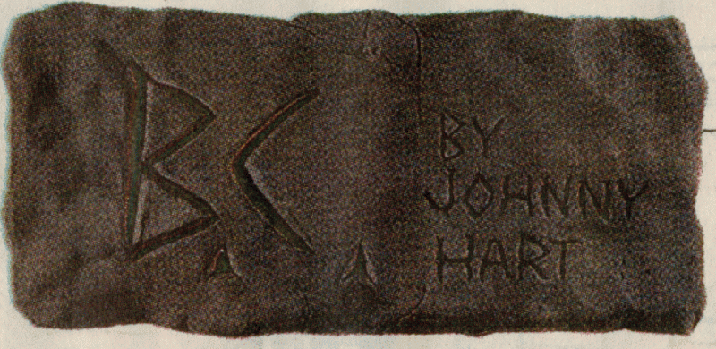

Slide 17
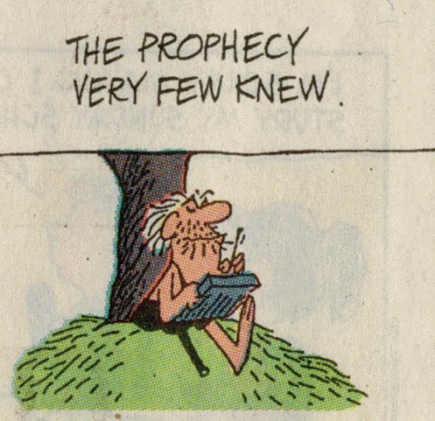

Slide 18
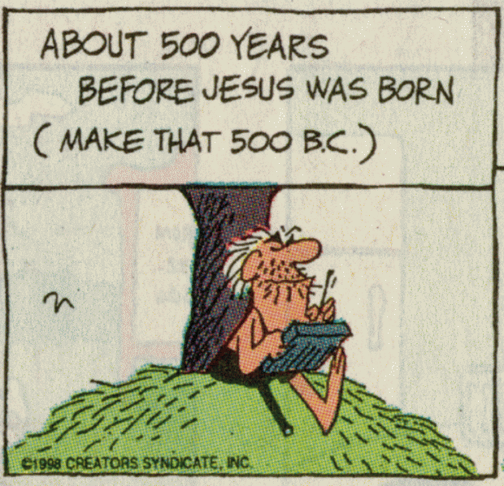

Slide 19
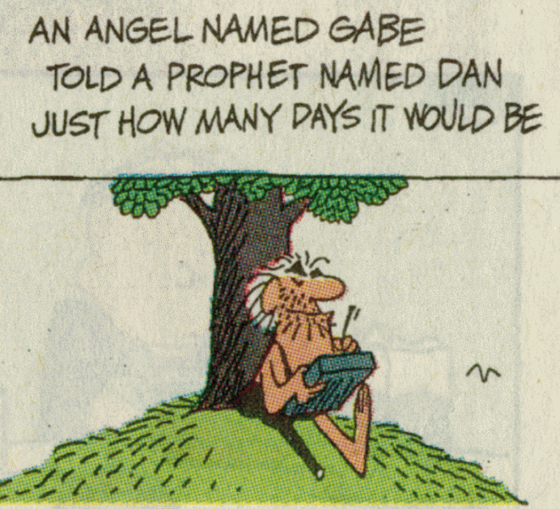

Slide 20
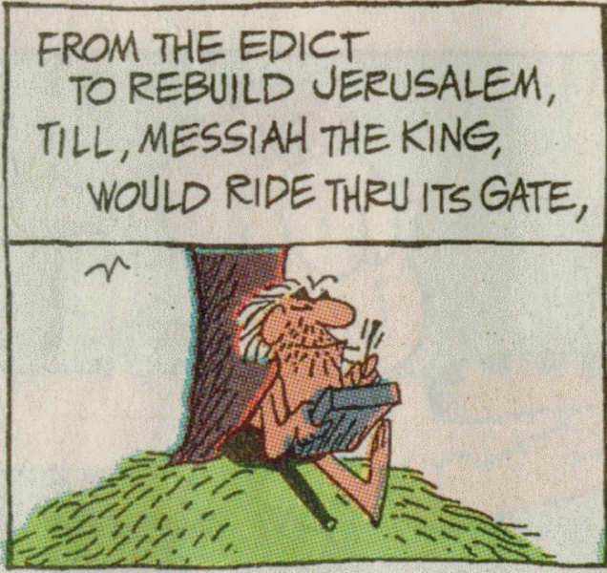

Slide 21
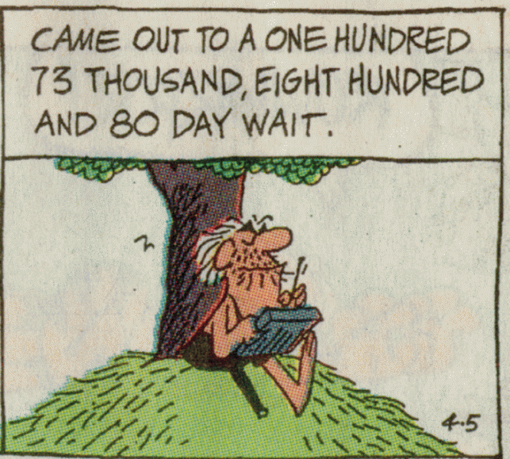

Slide 22
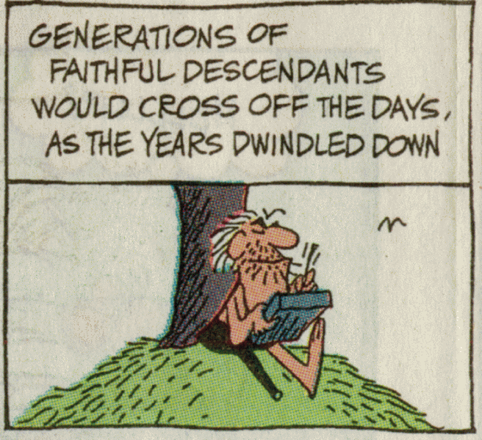

Slide 23
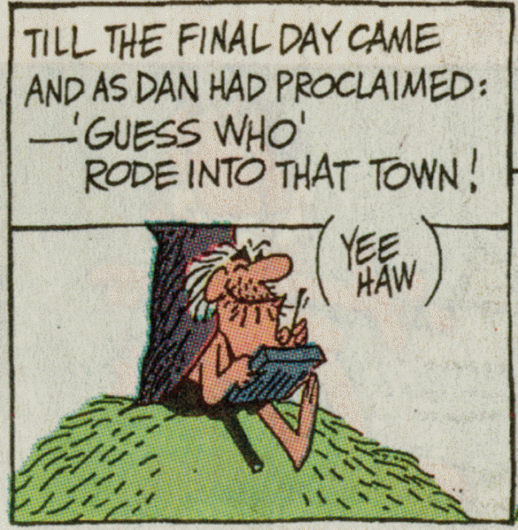

Slide 24
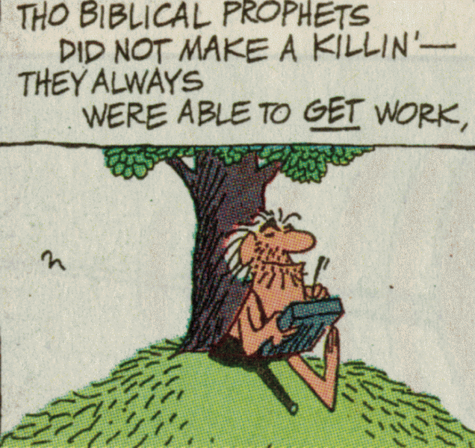

Slide 25
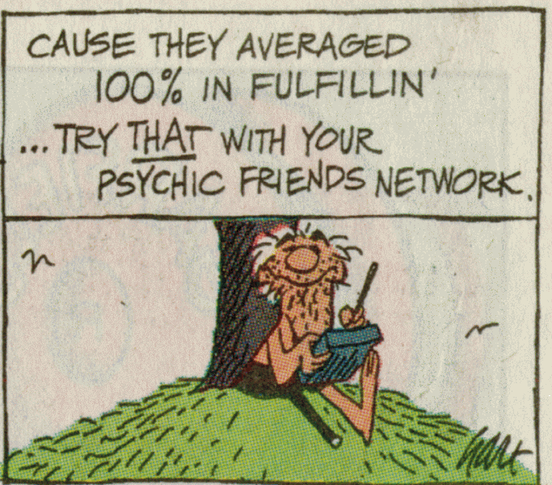

Slide 26
Daniel’s 70 “Sevens”
445
7
62
Messiah
Date of the triumphal entry? March 29, 33 A.D.
Date of the crucifixion? April 3, 33 A.D.
Daniel 9:26
26 After the sixty-two ‘sevens,’ the Anointed One will be cut off and will have nothing.

Slide 27
Daniel’s 70 “Sevens”
445
7
62
Messiah
70 AD
Jerusalem destroyed by Rome
Daniel 9:26
26 After the sixty-two ‘sevens,’ the Anointed One will be cut off and will have nothing. The people of the ruler who will come will destroy the city and the sanctuary. The end will come like a flood: War will continue until the end, and desolations have been decreed.

Slide 28
Daniel’s 70 “Sevens”
445
1
7
62
Messiah
70 AD
49 years
434 years
7 years
Jerusalem destroyed by Rome
Daniel 9:27
27 He will confirm a covenant with many for one ‘seven.’ In the middle of the ‘seven’ he will put an end to sacrifice and offering. And on a wing of the temple he will set up an abomination that causes desolation, until the end that is decreed is poured out on him.”

Slide 29
Daniel 9:24-27
When
Micah 5:2-4
Where
2 Sam 7
}
49
12:1-3
Who
3:15

Slide 30
EZEKIEL
“The Jeremiah
of Babylon”

Slide 31
Where is everyone in 597 BC?
Jeremiah
Ezekiel
Daniel
605
597
586
Deportations from Israel

Slide 32
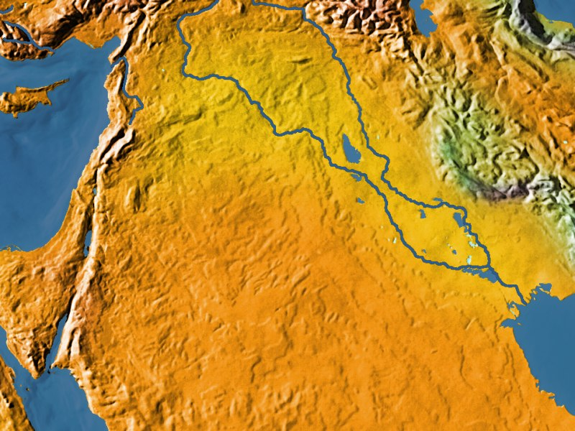
Where is everyone in 597 BC?
Jeremiah
Ezekiel
Daniel
Babylon
Jerusalem

Slide 33
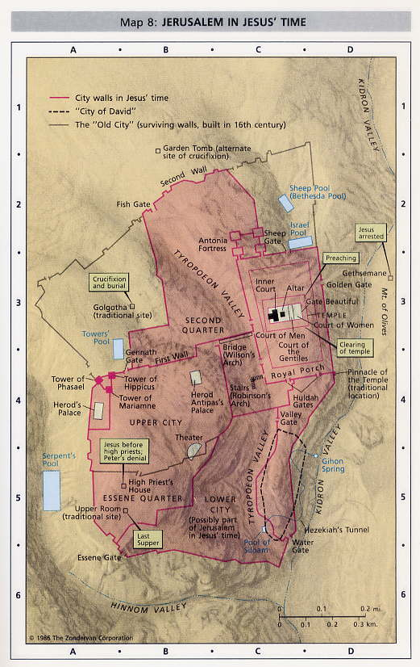

Slide 34
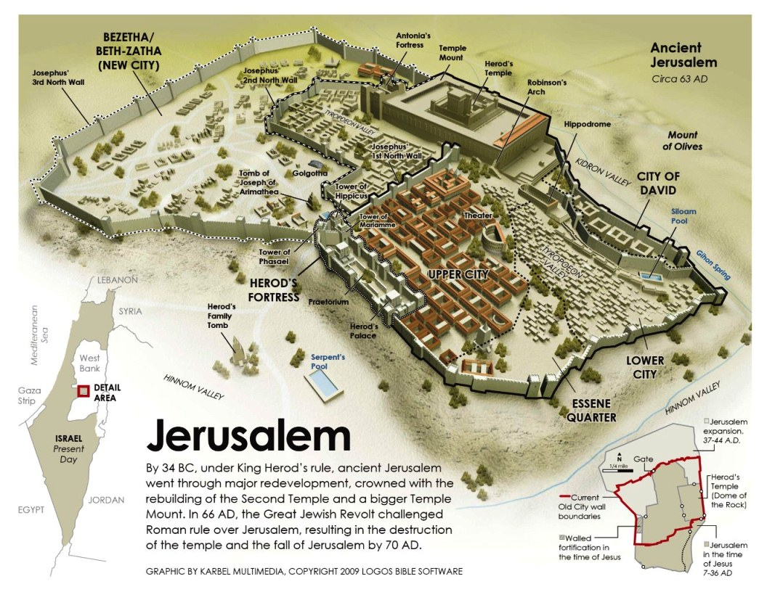

Slide 35
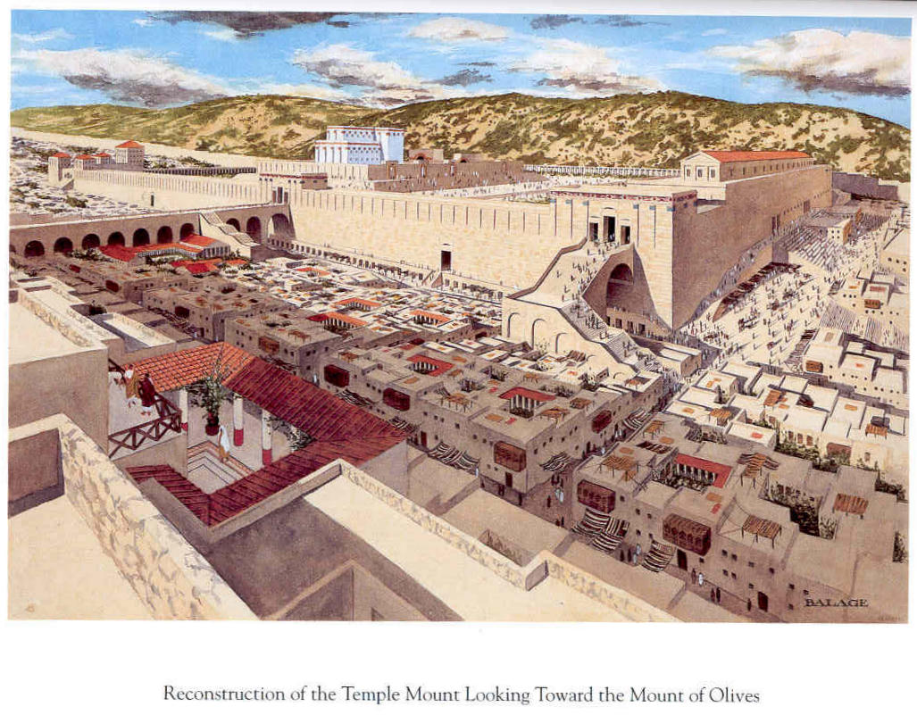

Slide 36
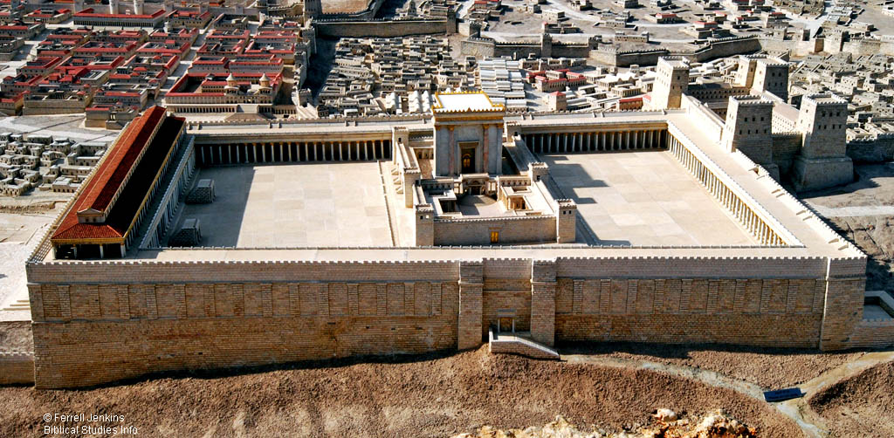

Slide 37
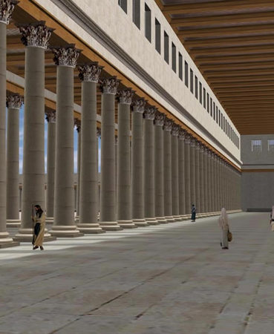
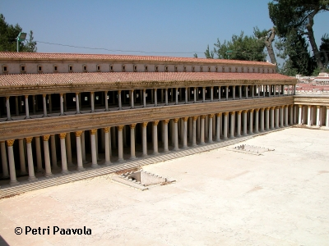
Solomon’s porch

Slide 39
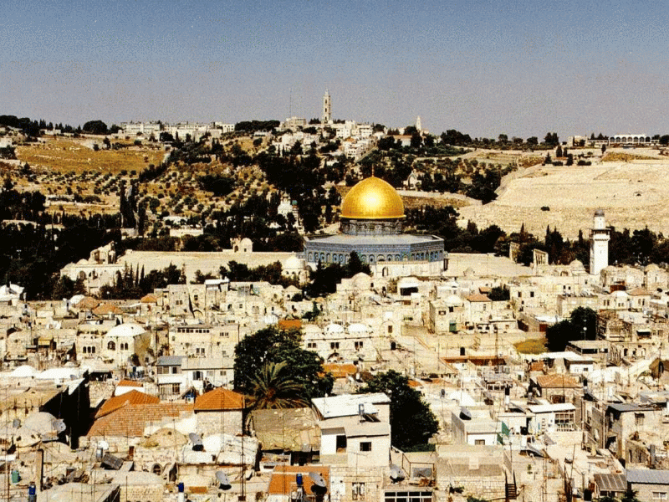

Slide 41
Ezekiel 8:3-4
3 He stretched out what looked like a hand and took me by the hair of my head. The Spirit lifted me up between earth and heaven and in visions of God he took me to Jerusalem, to the entrance to the north gate of the inner court, where the idol that provokes to jealousy stood. 4 And there before me was the glory of the God of Israel, as in the vision I had seen in the plain.

Slide 42
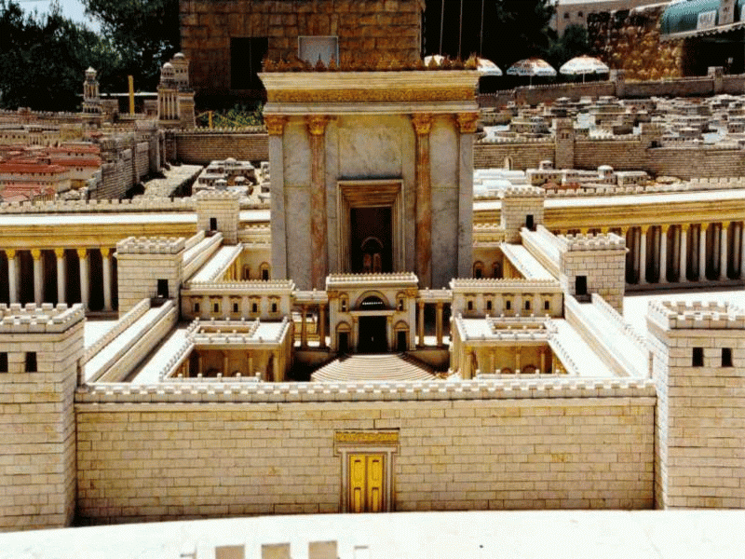

Slide 43
Ezekiel 8:3-4
3 He stretched out what looked like a hand and took me by the hair of my head. The Spirit lifted me up between earth and heaven and in visions of God he took me to Jerusalem, to the entrance to the north gate of the inner court, where the idol that provokes to jealousy stood. 4 And there before me was the glory of the God of Israel, as in the vision I had seen in the plain.

Slide 44
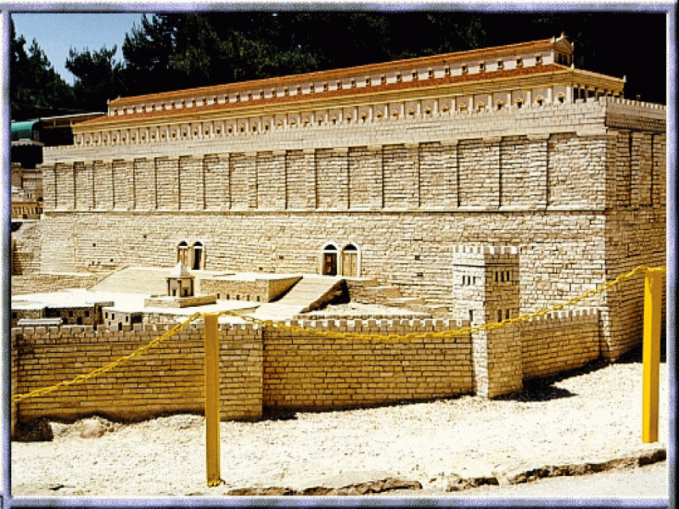

Slide 45
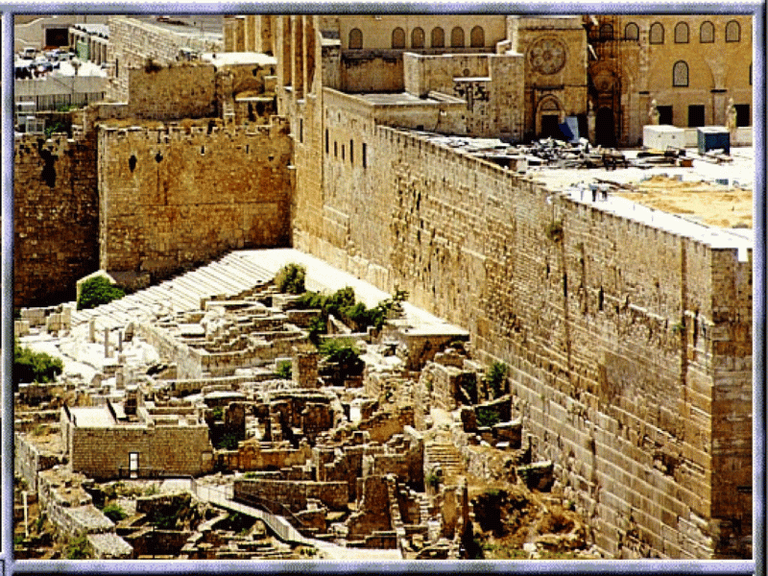

Slide 46
Ezekiel 8:6
6 And he said to me, “Son of man, do you see what they are doing—the utterly detestable things the house of Israel is doing here, things that will drive me far from my sanctuary? But you will see things that are even more detestable.”
10 So I went in and looked, and I saw portrayed all over the walls all kinds of crawling things and detestable animals and all the idols of the house of Israel.

Slide 47
Ezekiel 9:3
3 Now the glory of the God of Israel went up from above the cherubim, where it had been, and moved to the threshold of the temple.
Ezekiel 10:18-19
18 Then the glory of the LORD departed from over the threshold of the temple . . . stopped at the entrance to the east gate of the LORD’s house

Slide 48
Ezekiel 11:22-23
22 Then the cherubim, with the wheels beside them, spread their wings, and the glory of the God of Israel was above them. 23 The glory of the LORD went up from within the city and stopped above the mountain east of it.

Slide 49
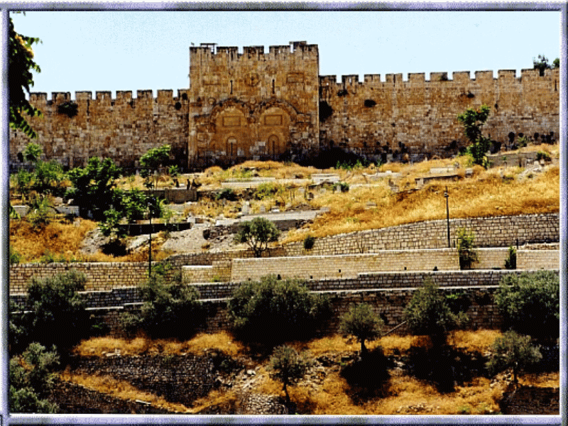

Slide 50
Zechariah 14:4
4 On that day his feet will stand on the Mount of Olives, east of Jerusalem, and the Mount of Olives will be split in two ...
Acts 1:11
11 “Men of Galilee,” they said, “why do you stand here looking into the sky? This same Jesus, who has been taken from you into heaven, will come back in the same way you have seen him go into heaven.”
Luke 19:29-30
29 As he approached Bethphage and Bethany at the hill called the Mount of Olives, he sent two of his disciples, saying to them, 30 “Go to the village ahead of you, and as you enter it, you will find a colt tied there, which no one has ever ridden. Untie it and bring it here.

Slide 51
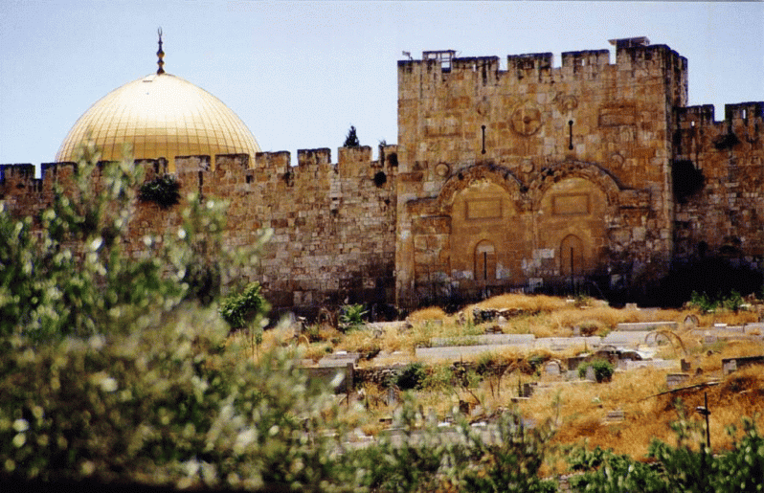

Slide 53
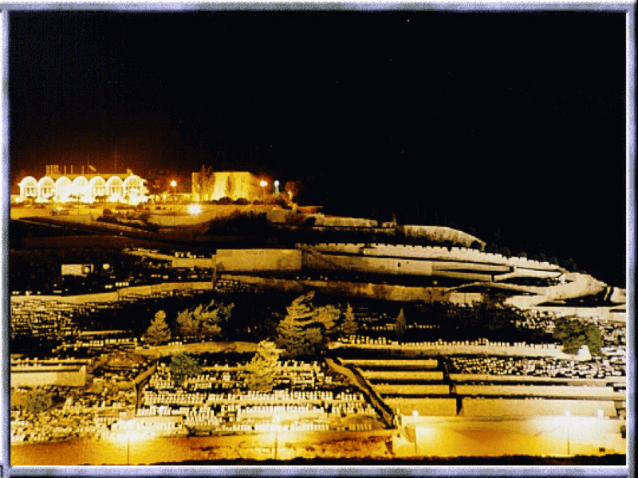

Slide 54
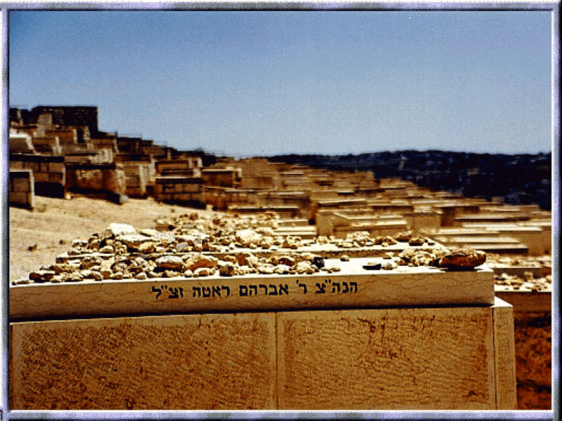

Slide 55
Acts 2:1 When the day of Pentecost came, they were all together in one place. 2 Suddenly a sound like the blowing of a violent wind came from heaven and filled the whole house where they were sitting.
3 They saw what seemed to be tongues of fire that separated and came to rest on each of them.
4 All of them were filled with the Holy Spirit and began to speak in other tongues as the Spirit enabled them.

Slide 56
1 Cor 6:19 Do you not know that your body is a temple of the Holy Spirit, who is in you, whom you have received from God? You are not your own; 20 you were bought at a price. Therefore honor God with your body.

