Slide 1
Eschatology
CBI Theology Seminar

Slide 2
Eschatology in Broad Categories
Personal Eschatology
Death, life after death (intermediate state)
Cosmic Eschatology
Kingdom of God, Rapture, tribulation, millennium, judgment, NH/NE

Slide 3
Eschatology in Broad Categories
Personal Eschatology
Death, life after death (intermediate state)
Cosmic Eschatology
Kingdom of God, Rapture, tribulation, millennium, judgment, NH/NE

Slide 4
Death/Intermediate State
Death is not natural, it was brought on by the Fall (Gen 2:17; cf. Gen 5).
Death is not the end, there is an afterlife seen in Scripture.
While there is not abundant detail in the OT about the afterlife, we know it was believed in and a resurrection to everlasting life or death was expected (Dan. 12:1-3).
People were on the lookout in the OT for the One who would free them from the curse (Gen 3:15; cf. Gen 5:28-29). Jesus is the One who defeated death (1 Cor. 15:1-56).

Slide 5
Death/Intermediate State
The NT notes that all humanity, upon death, enters into a temporary intermediate state of comfort with God or torment because of their unbelief (Luke 16:19-31; 23:43; Phil. 1:21-23; 2 Cor. 5:1-10).

Slide 6
Judgment
Christ will return and when he does he will display his glory in both judgment and salvation.
All of humanity will appear before the judgment seat of Christ (2 Cor. 5:10). Jesus likens this to a separation of sheep (believers) and goats (unbelievers) who have judgment rendered to them (Matt. 25:31-46).
This judgment is final, decisive, and determinative (Heb. 9:27), and is based on repentance and faith in Jesus Christ alone for salvation (John 14:6; Acts 4:12; Rom. 10:9-17; 2 Thess. 1:5-10).

Slide 7
Judgment
Those who believe are granted eternal life, which depicts reality without death in the new heavens and new earth (Rev. 21-22).
Those who don’t believe are cast into the lake of fire forever (called the second death; Rev 20:11-15). Hell is real, eternal, conscious torment.

Slide 8
New Creation
This is the final state of existence for believers once we are resurrected (1 Cor. 15:50-58; 2 Pet. 3:8-13; Rev. 21:1-4).
Tabernacle/Temple- God will dwell with us (Ex. 29:44-45; Rev. 21:3).
A city (Heb. 11:9-10; Rev. 21:17, 24, 26; 22:3).
Our true homeland (Heb. 11:13-16).
A wedding feast (Rev. 19:9, 21:2, 9-14; Eph. 5:27).
A kingdom- God will rule and reign and His people will live in perfect harmony.
A garden (Gen. 2; Rev. 22:1-3).
A family reunion (John 14:1-2).
A place of restoration- no more tears, sorrow, mourning, or death (Rev. 21:4).

Slide 9
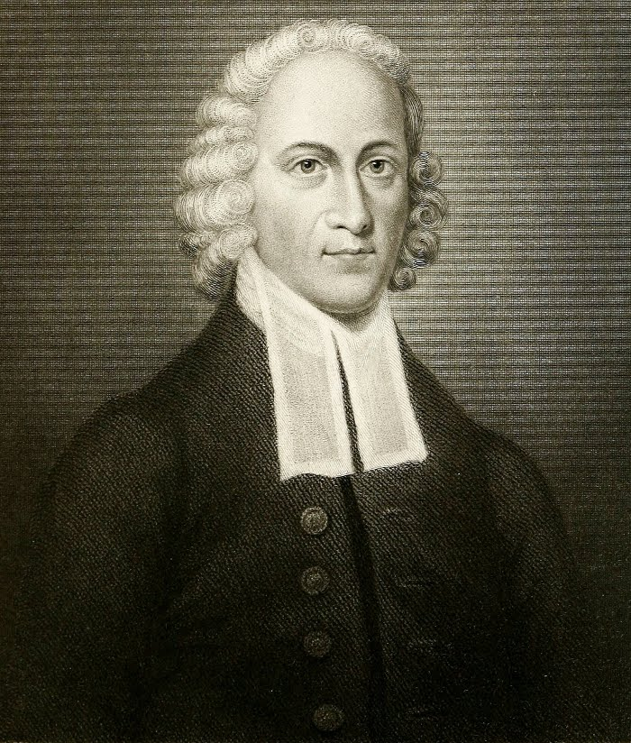
Heaven is a world of love
“There this glorious God is manifested, and shines forth, in full glory, in beams of love. And there this glorious fountain forever flows forth in streams, yea, in rivers of love and delight, and these rivers swell, as it were, to an ocean of love, in which the souls of the ransomed may bathe with the sweetest enjoyment, and their hearts, as it were, be deluged with love!”
- Jonathan Edwards, Heaven is a World of Love

Slide 10
The Reality of New Creation

Slide 11
Hope and Purpose
We should grieve in this life, but not as those who have no hope (1 Thess. 4:13).
We should suffer with a forward-looking perspective (2 Cor. 4:16-18).
We should be a forgiving people, knowing that judgment belongs to God (Rom. 12:19-21).
We should reject present utopianism, looking to a future kingdom.
We should approach the Christian life with a future orientation, with freedom from sin, not defined by our past, failures, or our accomplishments.
We should value evangelism, church membership, corporate worship, and global missions.
We should live for the glory of God as good stewards of all He has given to us, knowing one day we will stand before our Lord.

Slide 12
Application for Our Disciplines
Other worldviews affirm no afterlife, and no eternal judgment or salvation (focus is on science, technology, fitness, entertainment, power, pleasure, or success as savior), or perhaps some different rendition of these items (i.e., alternative religions).
This means there will be vast differences in relation to how we work in our discipline, namely, with hope, a particular purpose, and an eye to the future. We have a different motivation in our work.
Our research will be done with excellence, as well as an eye to a future day of restoration.
Our teaching will guide students to achieve great things in their field, doing their work as unto the Lord, as a steward of the good gifts God has given to them.
Our values and pursuits will be grounded in an eternal perspective. Our fields are important, we operate in a fallen world, and await the coming day of restoration.

Slide 13
Review
The Center for Biblical Integration at Cedarville University promotes biblical and theological understanding for the sake of applying biblical truth to the teaching and research done by all of our faculty members. The Center serves as a resource to help faculty establish and build upon a biblical and theological foundation so as to think theologically about their respective academic disciplines and discern the nexus between biblical-theological truth and all of life. Renewing our minds in the truth of Scripture and theology will equip us for the task of affirming, rejecting, or redeeming the various presuppositions, findings, and conclusions within our respective fields.
Notes:
In integration it is key to think about specific passages of Scripture, but also to widen our scope in terms of thinking in theological categories. Examples.

Slide 14
Review
Doctrinal Overview
Theology and Worldview
Revelation
Hermeneutics
God and Creation
Humanity and Sin
Christ
Salvation
Church
Holy Spirit
Last Things

Slide 15
Bible
Theology
Worldview
Presuppositions Findings Interpretations Conclusions
Reject Receive Redeem
Notes:
Often times we are answering worldview questions in our fields as our integrative work, but we can never forget that the content provided as answers for those question is found in the Bible and theology.

